Slide 1
Researching Community Food Economies
Oona Morrow, PhD
Morrowo@tcd.ie
October 4, 2016
Sustainability and Social Contestation, Utrecht University

Slide 2
Outline
Introduction – Research & Work
Community Economies Research
Urban Homesteading: Diverse Economies, Gender & Self-Provisioning
Community Food Economies: Growing Urban Commons and Collectivity
SHARECITY: Mapping Diverse Food Economies and New Infrastructures for Commoning
Next Steps and Questions

Slide 3

Research & Work
Nature-Society
Geography
Food Studies
Community
Economies
Urban Studies
Feminist Geography
Sustainability
Poverty
Food Security
Social Reproduction
Policy
Care Work
Notes:
Teaching in Food Studies during my PhD geography – doing community economies research – and interest in community development, etc. – led me to take a research and grantwriting position at an antipoverty agency which delivers a number of government programs designed to address food insecurity, poverty, and early education and care. They ran food pantries, child care centers, and helped people access a variety of public food benefits like SNAP and WIC. Gross‘s experience resonates very much with my own in terms of the constraints of funders – the need to produce outcomes that can be evaluated. Doing an enormous amount of work to attract funding for a very narrow „evidence based“ model that does not even begin to address the problem and is not responsive to local community needs.

Slide 4
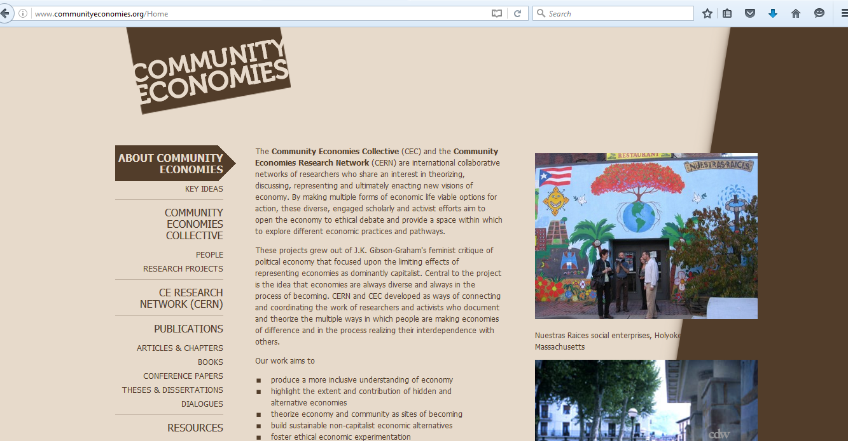
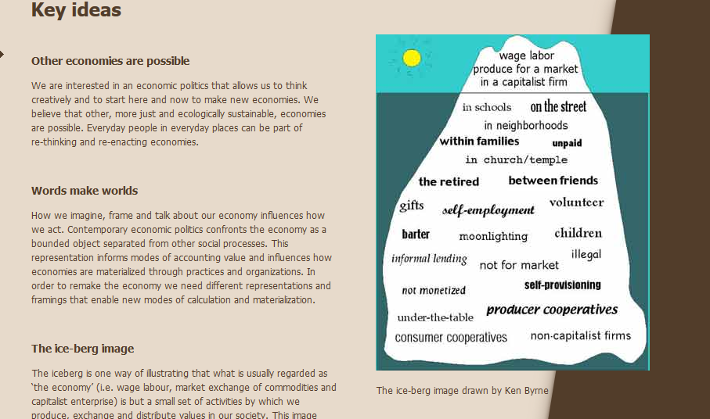
Community Economies Research
(www.communityeconomies.org)

Slide 5
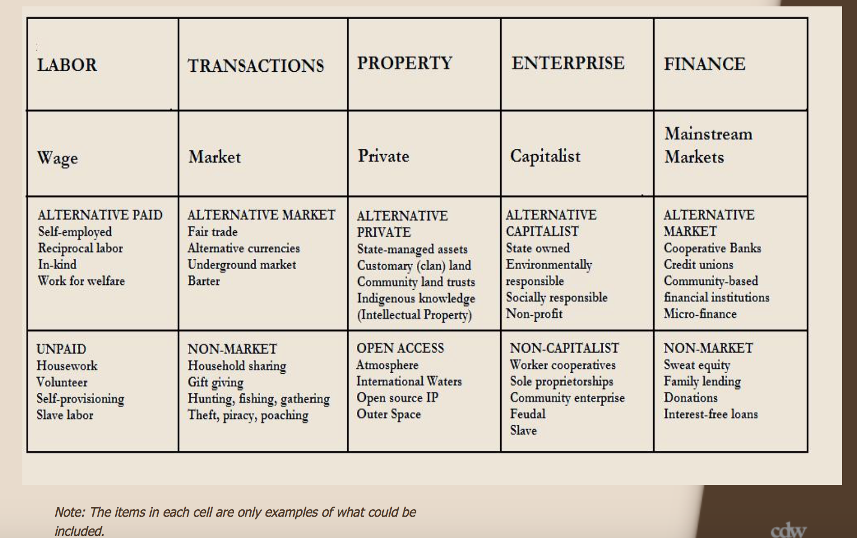
Diverse Economies
(www.communityeconomies.org)

Slide 6
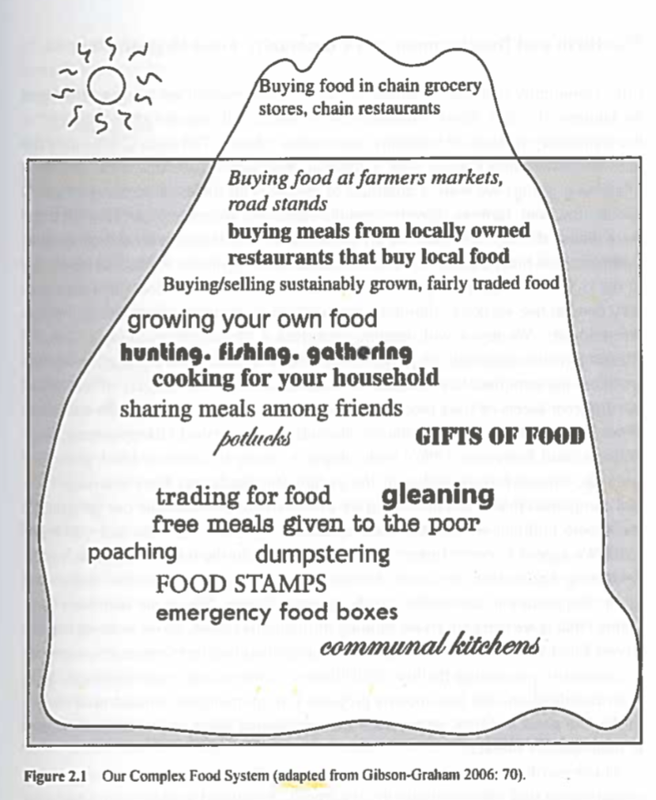
Diverse Food Economies
(Gross 2014)

Slide 7
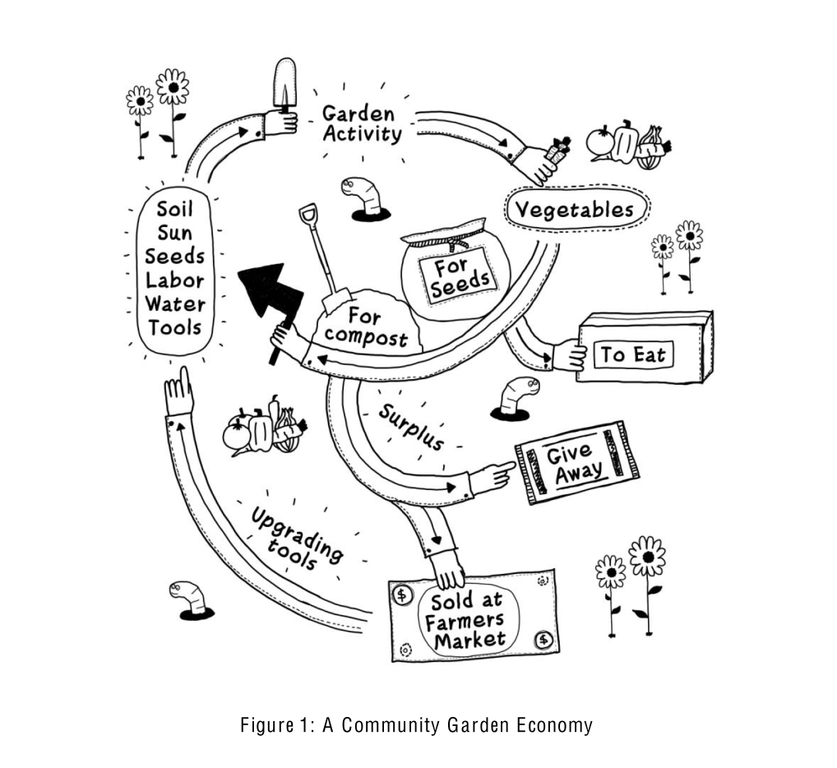
Community Food Economies
A community economy is a space of interdependence and ethical negotiation around:
-what is necessary to personal and social survival;
-how social surplus is appropriated and distributed;
-whether and how social surplus is to be produced and consumed; and
-how a commons is produced and sustained (Gibson-Graham 2006)
(Gibson-Graham, Cameron, and Healy 2013)

Slide 8
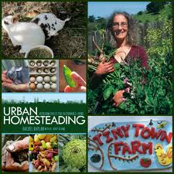
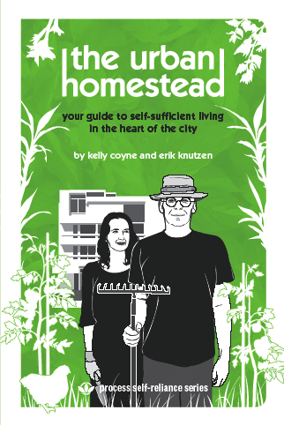
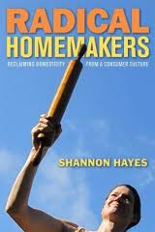
Urban Homesteading
Notes:
National movement /Trend related to Urban Ag.

Slide 9
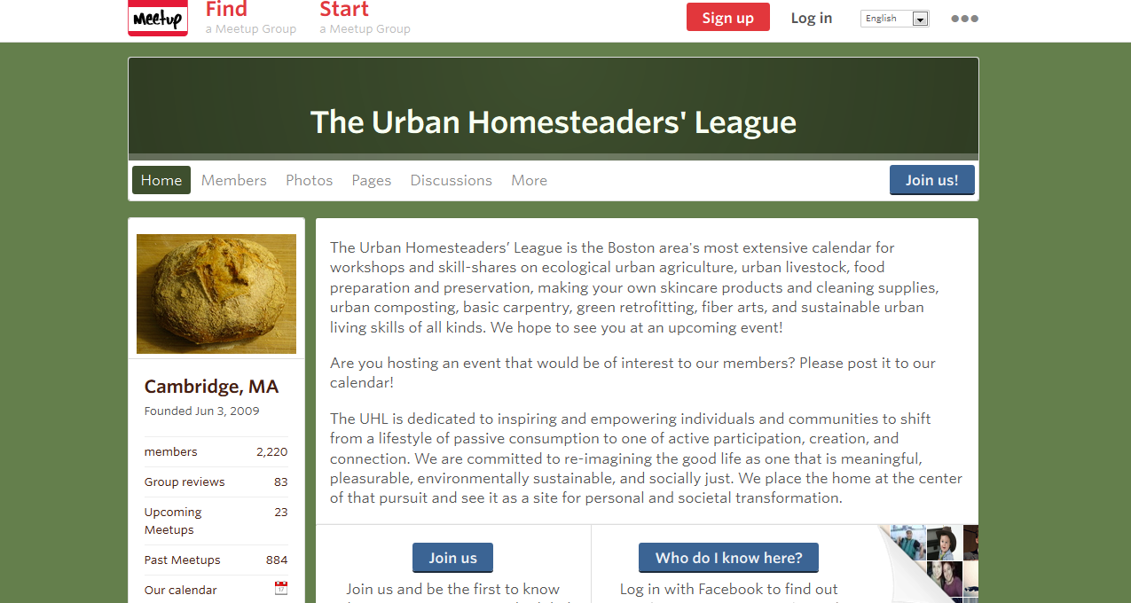
Urban Homesteaders League, Boston
We are committed to re-imagining the good life as one that is meaningful, pleasurable, environmentally sustainable, and socially just. We place the home at the center of that pursuit and see it as a site for personal and societal transformation

Slide 10
Research Questions
How are social and economic relations (re)configured under self-provisioning practices?
  What kinds of social relations (e.g. gender, race, ethnic, and class relations, friendships, voluntary associations, place based communities) are self-provisioning practices embedded in and enabled by?
  What kinds of economic relations (e.g. gender divisions of labor, barter networks, supply chains, property regulations, zoning, production, consumption, and distribution networks) are self-provisioning practices embedded in and enabled by?
  What is the impact of self-provisioning practices on social and economic relations at multiple urban scales within and beyond the home?

Slide 11
Methodology
Method | Objectives
Media Analysis of Urban Homesteading blogs, books, and news articles | Defining Urban Homesteading. Identifying popular discourses and identities associated with UH. Developing a sampling frame.
Participant Observation at Urban Homesteaders League Events | Developing an experiential understanding of self-provisioning. Meeting potential interviewees.
In-depth interviews and site visits (n 40) | Identifying self-provisioning skills and practices, motivations, spaces, values, and experiences.
Participatory Action Research (e.g. events organizing, participatory mapping, ongoing activist-scholar collaborations) | To create urban commons that support collective forms of provisioning. To increase the visibility of diverse food economies in Greater Boston

Slide 12
Diverse Food Economies in Boston
Labor | Transactions | Property | Enterprise
Wage | Market | Private | Capitalist
ALT. PAID Self-employed Paid in Food | ALT. MARKET Farmers market Craft market Barter | ALT. PRIVATE Community garden Shared backyard and kitchen Urban Commons | ALT. CAPITALIST Non-profit learning Social Enterprise
UNPAID Self-provisioning Housework Volunteer Work Party | NON-MARKET Gifting Sharing of skills, food, materials Gleaning, Foraging, Gathering | OPEN ACCESS Online Knowledge Commons Seed library Public Fruit Urban Commons | NON-CAPITALIST Households (communal, feudal, and ancient). Neighborhood Cooperative Community Enterprise
Notes:
While the research began with questions about home, households, gender, and domestic labor, I soon realized that household sustainability and self-provisioning depended upon a diversity of labor practices, transactions, property arrangements, and enterprises that extended the boundaries of home – including barter networks, cooperative kitchens, community enterprises, and urban food commons. I found that urban homesteading is part of a broader diverse food economy in Boston. I wasn’t able to examine all of these practices in the dissertation. Throughout the research the diverse economies framework has served as an organizing framework, for the kinds of questions I’ve asked, but my analysis of these key concepts and practices has engaged with a much broader set of literature – in urban geog, feminist econ. Geog, and nature-society geog.

Slide 13
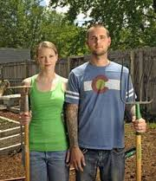
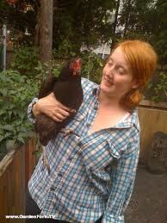
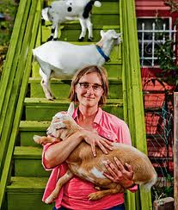
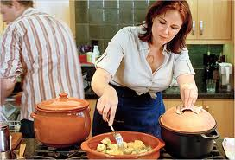
Gender and Self-Provisioning

Slide 14
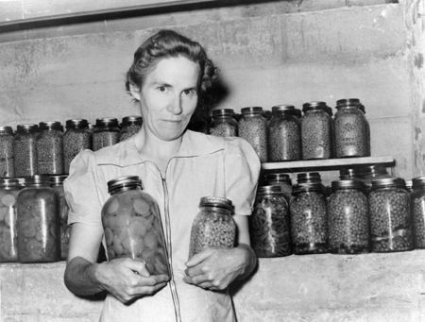
Gender and Self-Provisioning
I was just alone in our kitchen, doing the same thing over and over again, every week.….And honestly I just felt like "What am I doing spending so much time on doing things that only benefit me and my husband?" you know that we're going to eat it and then it’s going to be gone. And it’s not like I'm saving a huge amount of money. I mean it’s like a choice, a lifestyle choice, and for me, ultimately, I'm really glad I've done this, I'm really glad I know how to do these things, but I don't feel the need to do it all the time always. Because I want a more open life (Lisa, artist, Cambridge)

Slide 15
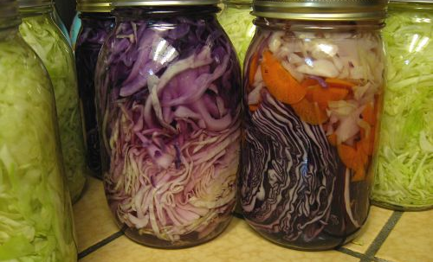
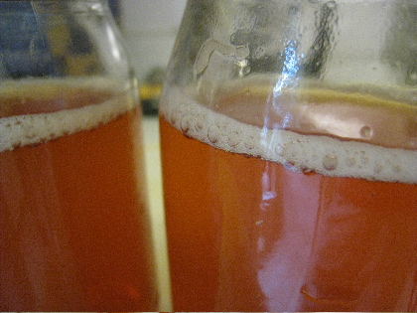
Gender and Self-Provisioning
If you come at it with the sort of mentality that you’re taking care of something, its not, it doesn’t feel like work, as much as it’s like feeding your kids, or watering your plants…. So it’s not like a task, so much, so that’s really it. There’s taking care of my cultures and then there’s the benefit it has for my kids and you know our health (Mike, tech worker, Arlington)

Slide 16
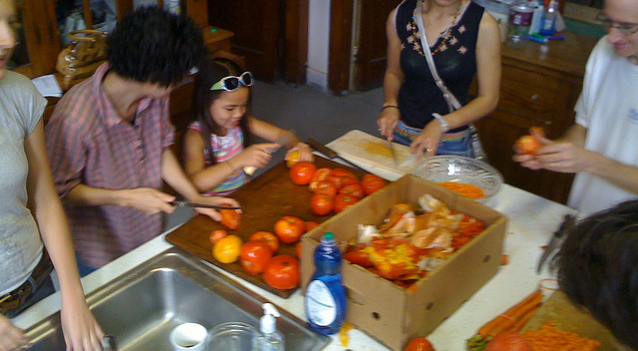
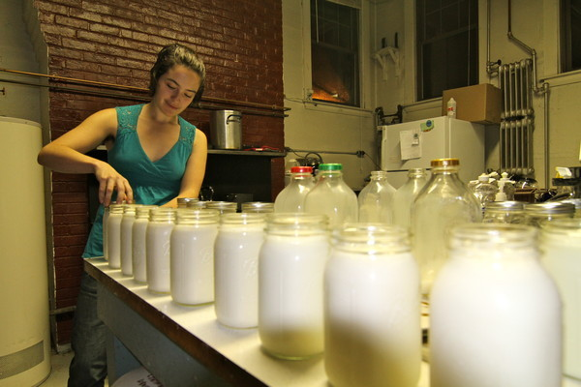
Collectivity and Commons
I think having a cooperative is itself political because it’s another structure, a different structure, that we need to have more examples of and learn how to do (Regina, unemployed, Cambridge)
I guess it’s a way of living that’s enjoyable, you know even though we’re in an urban area. And it seems to be really hard to do, but there’s all these little ways to do it that are fun and social, and they just open up new kinds of opportunities for, you know, just doing things, And almost everything.

Slide 17
Community Food Economies
A community economy makes and shares a commons-‑without a commons, there is no community, without a community, there is no commons (Gudeman 2016)
(Gibson-Graham, Cameron, and Healy 2013)

Slide 18
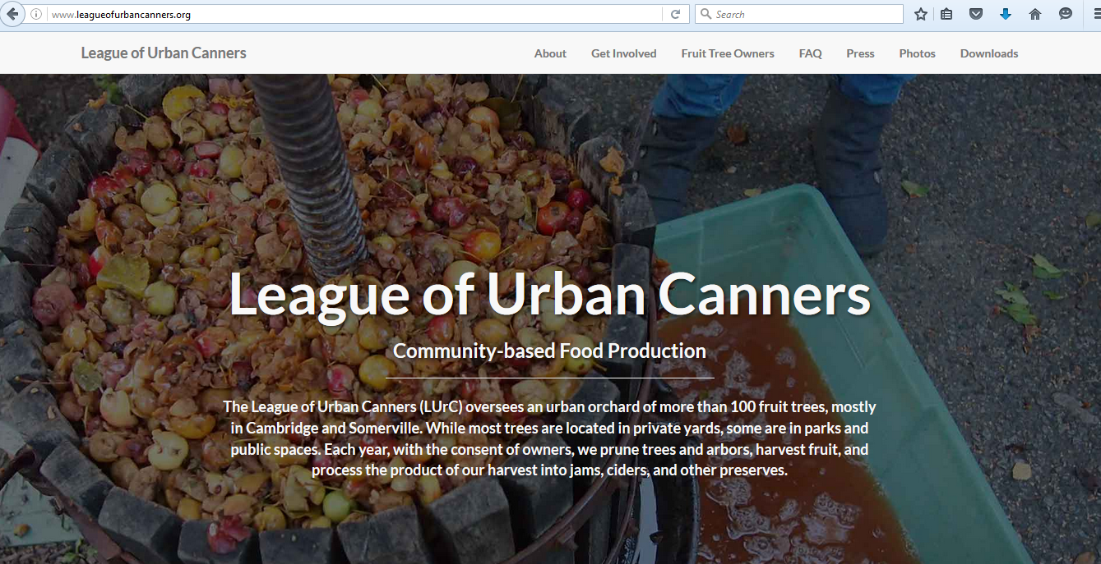
League of Urban Canners

Slide 19
Community Food Economies
How can cooperative food enterprises share and cultivate commons?

Slide 20
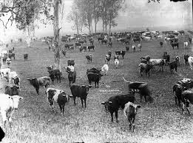
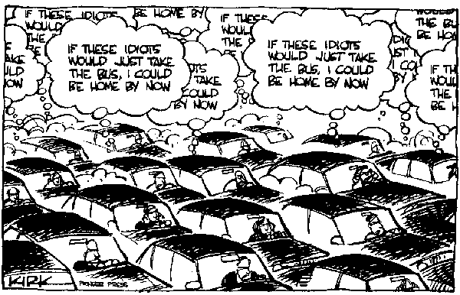
The Commons
Notes:
Commons are not found they are made – not fixed quantities of stuff – but a set of social practices around sharing creates a commons.

Slide 21
Community Food Economies
How can we use our research practices to create and care for commons, and make them more real and imaginable?

Slide 22
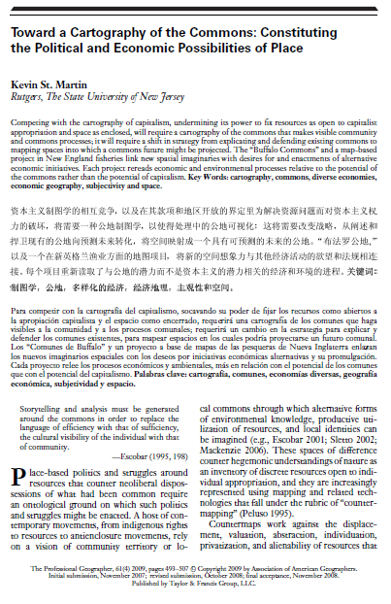
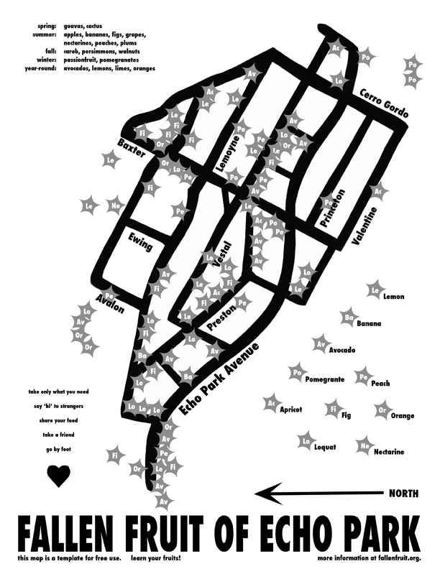
Mapping the Commons

Slide 23
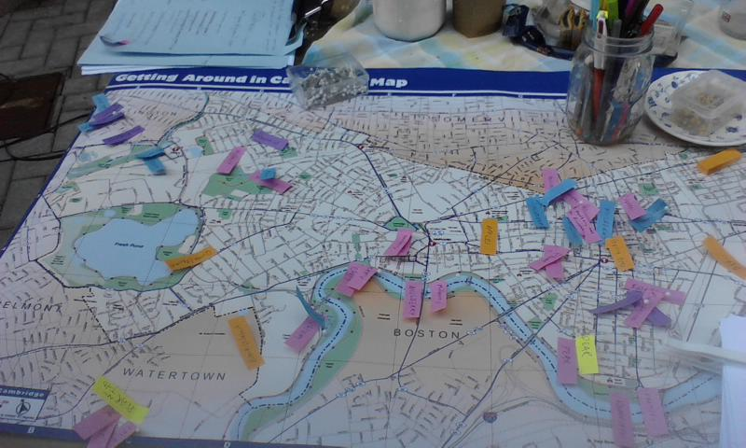
Mapping an Urban Food Commons

Slide 24
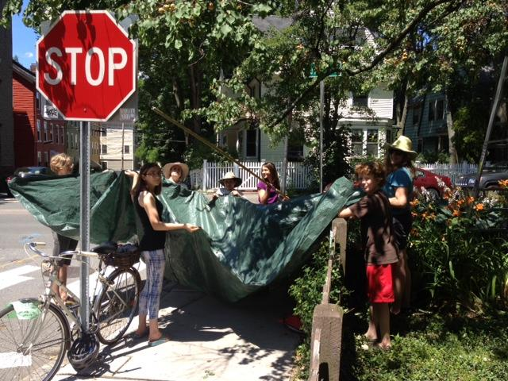

Slide 25
Community Food Economies
How are access, care, responsibility, benefit, and ownership negotiated around urban food commons?

Slide 26
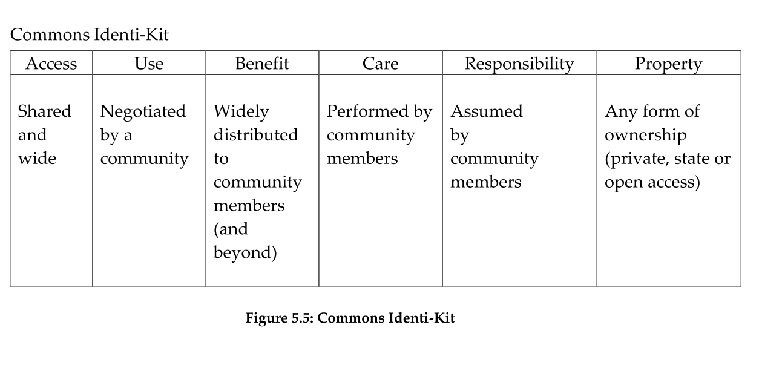
Commons Identi-Kit
(Gibson-Graham, Cameron, and Healy 2013)

Slide 27
Negotiating Urban Food Commons
 | Use | Access | Care | Responsibility | Benefit | Ownership
League of Urban Canners | Private Yards used by LURC to harvest fruit | By Permission of Property Owner | LURC – provides pruning and some pest management | Property Owner | LURC- free fruit and fun Owner – clean yard, 10% of harvest | Private – individually owned
“Commons IdentiKit” Adapted from Gibson-Graham, Cameron, and Healy 2014

Slide 28
Negotiating Access
By permission of property owners

Slide 29
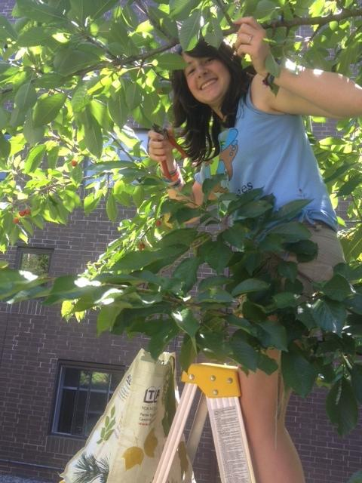
Practicing Care
League members provide pruning and pest management services

Slide 30
Sharing Responsibility
Property Owners and Liability Waivers

Slide 31
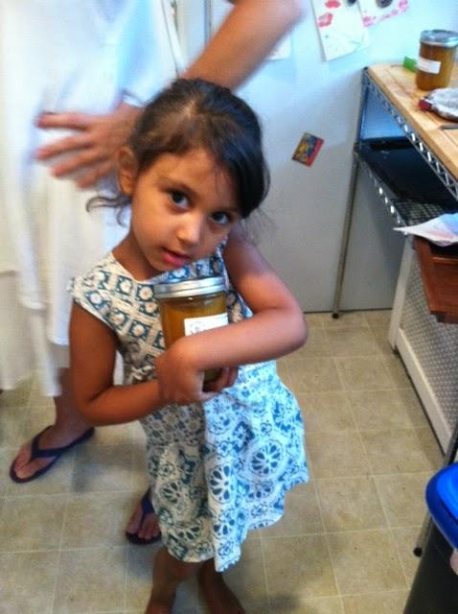
Distributing Benefits
LURC – Free fruit & fun
Preservers– 70%
Harvesters – 20%
Owners – Clean yard, and 10% of harvest

Slide 32
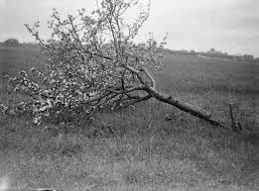
Ownership
Mostly Private

Slide 33
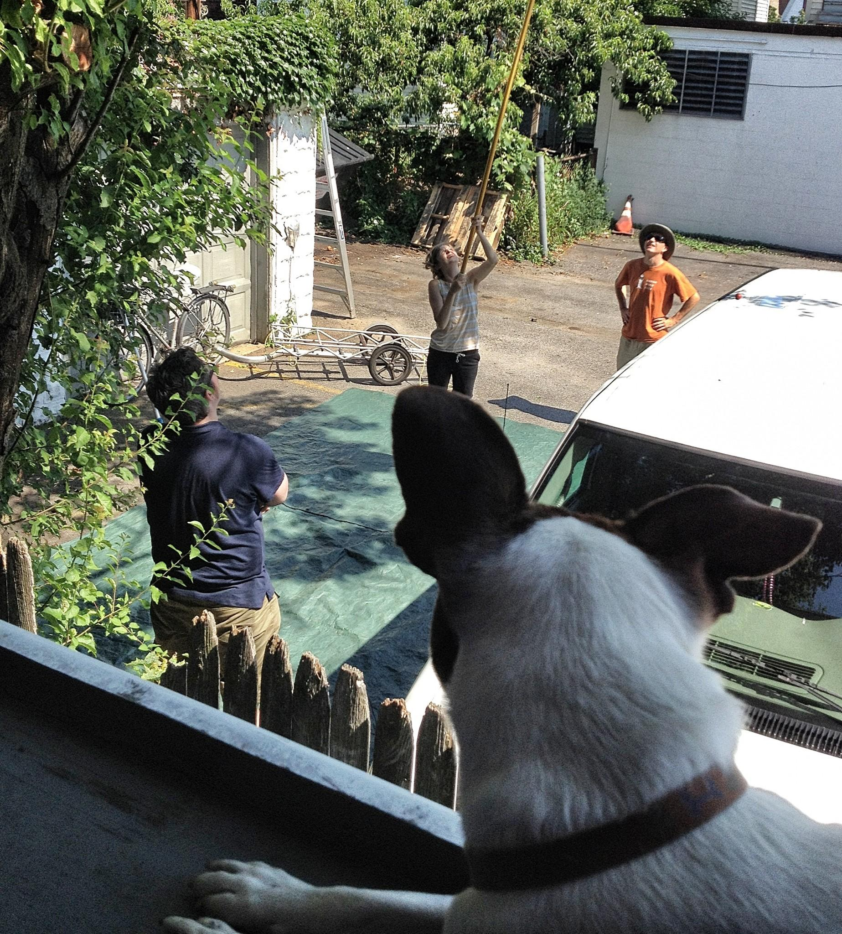

Slide 34
New Directions
Collective Infrastructure for Community Food Economies
The role of Law and Policy in Governing Community Food Economies
Social difference in Diverse and Community Food Economies
New Technologies for Commoning

Slide 35
SHARECITY: Aims and Objectives
SHARECITY will assess the practice and sustainability potential of city-based ICT-enabled food sharing economies by:
  Developing deeper theoretical understandings of contemporary food sharing
  Generating comparative international data about food sharing activities
  Assessing the sustainability impacts of food sharing activities
  Exploring how food sharing in cities might evolve in the future

Slide 36
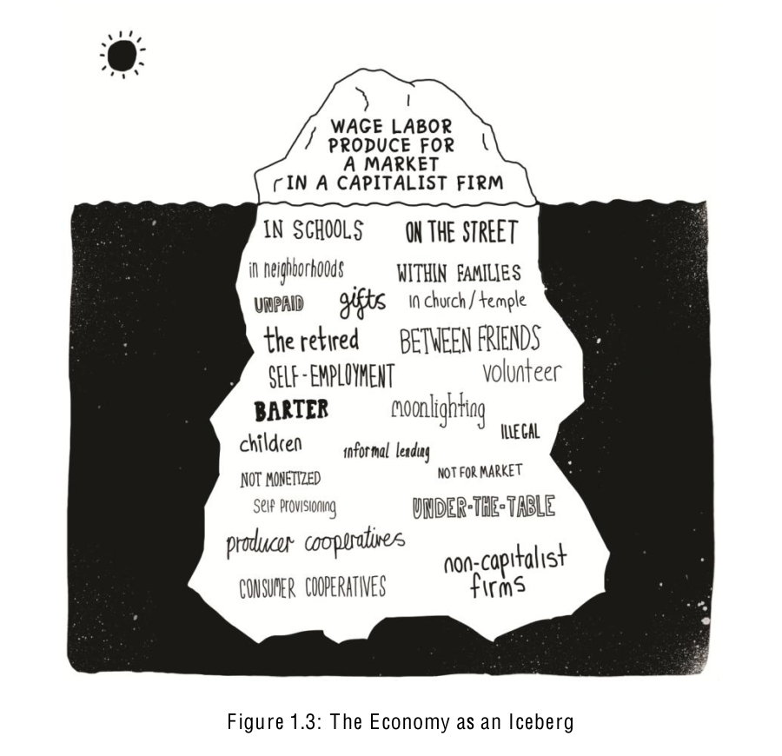
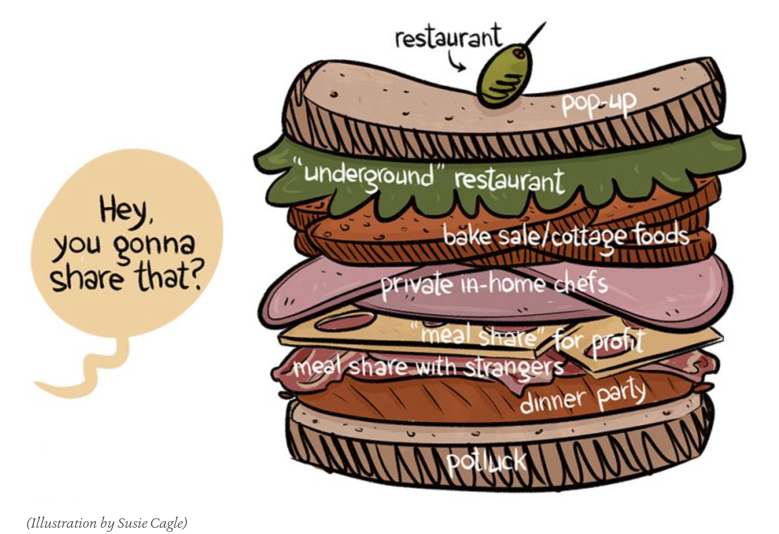
Diverse Economies of Food Sharing
(Gibson-Graham, Cameron, and Healy 2015)
(Cagle 2014)

Slide 37
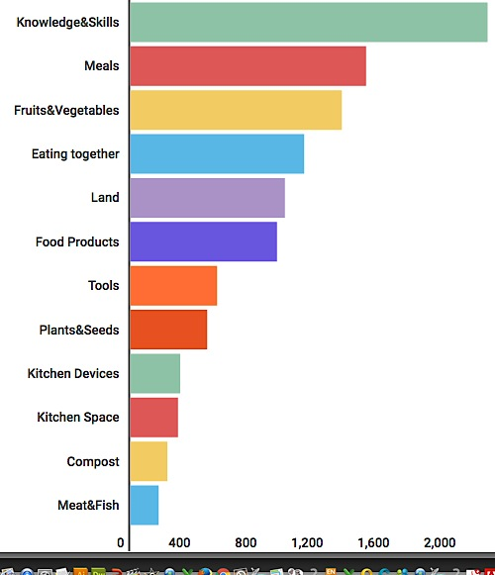
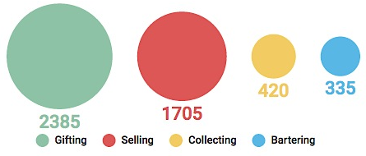
What is Shared and How ?
What is shared?
Multi functionality
e.g. Community Gardens
What is shared? How is it shared?
Land Gifting
Tools Collecting
Compost Bartering
Knowledge and Skills
How it is shared?
Number of Enterprises

Slide 38
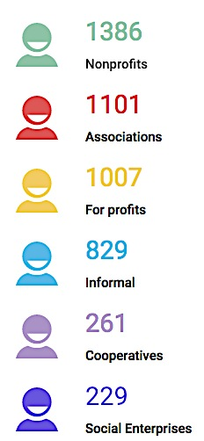
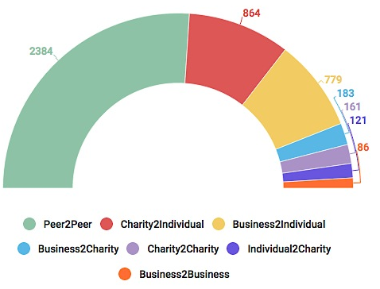
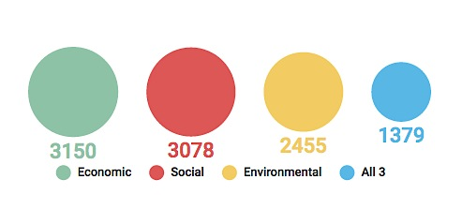
Organization of sharing and flows

Slide 39
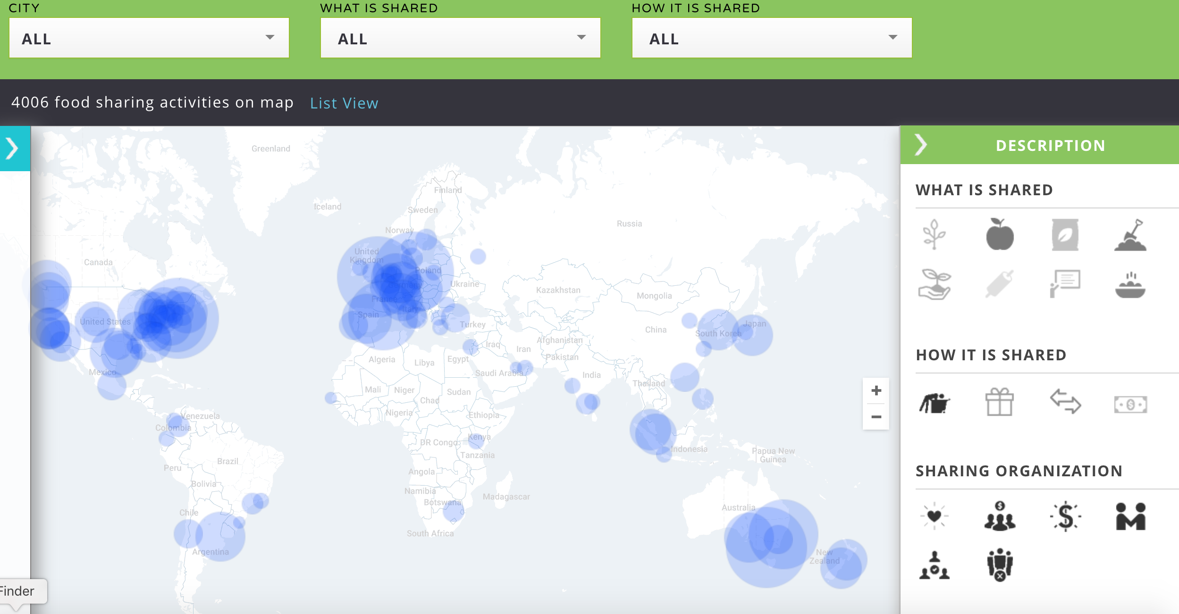
Performing Diverse Food Economies

Slide 40
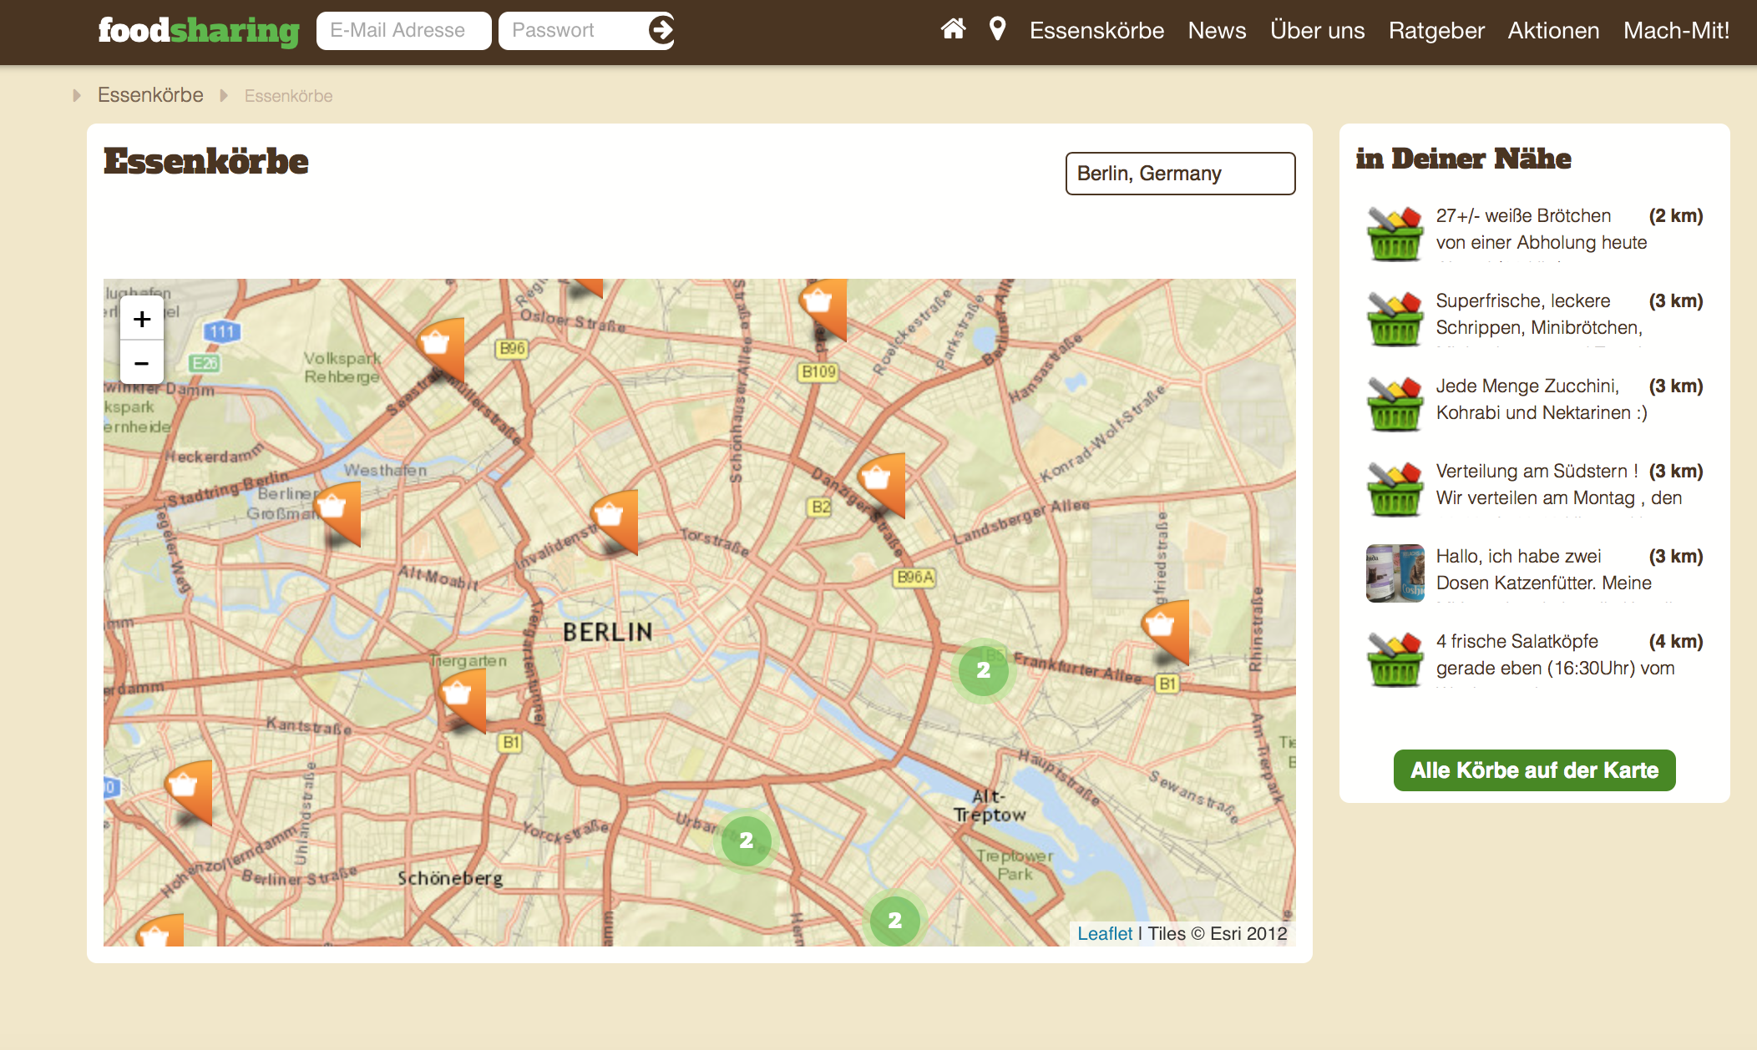
Technologies for Commoning

Slide 41
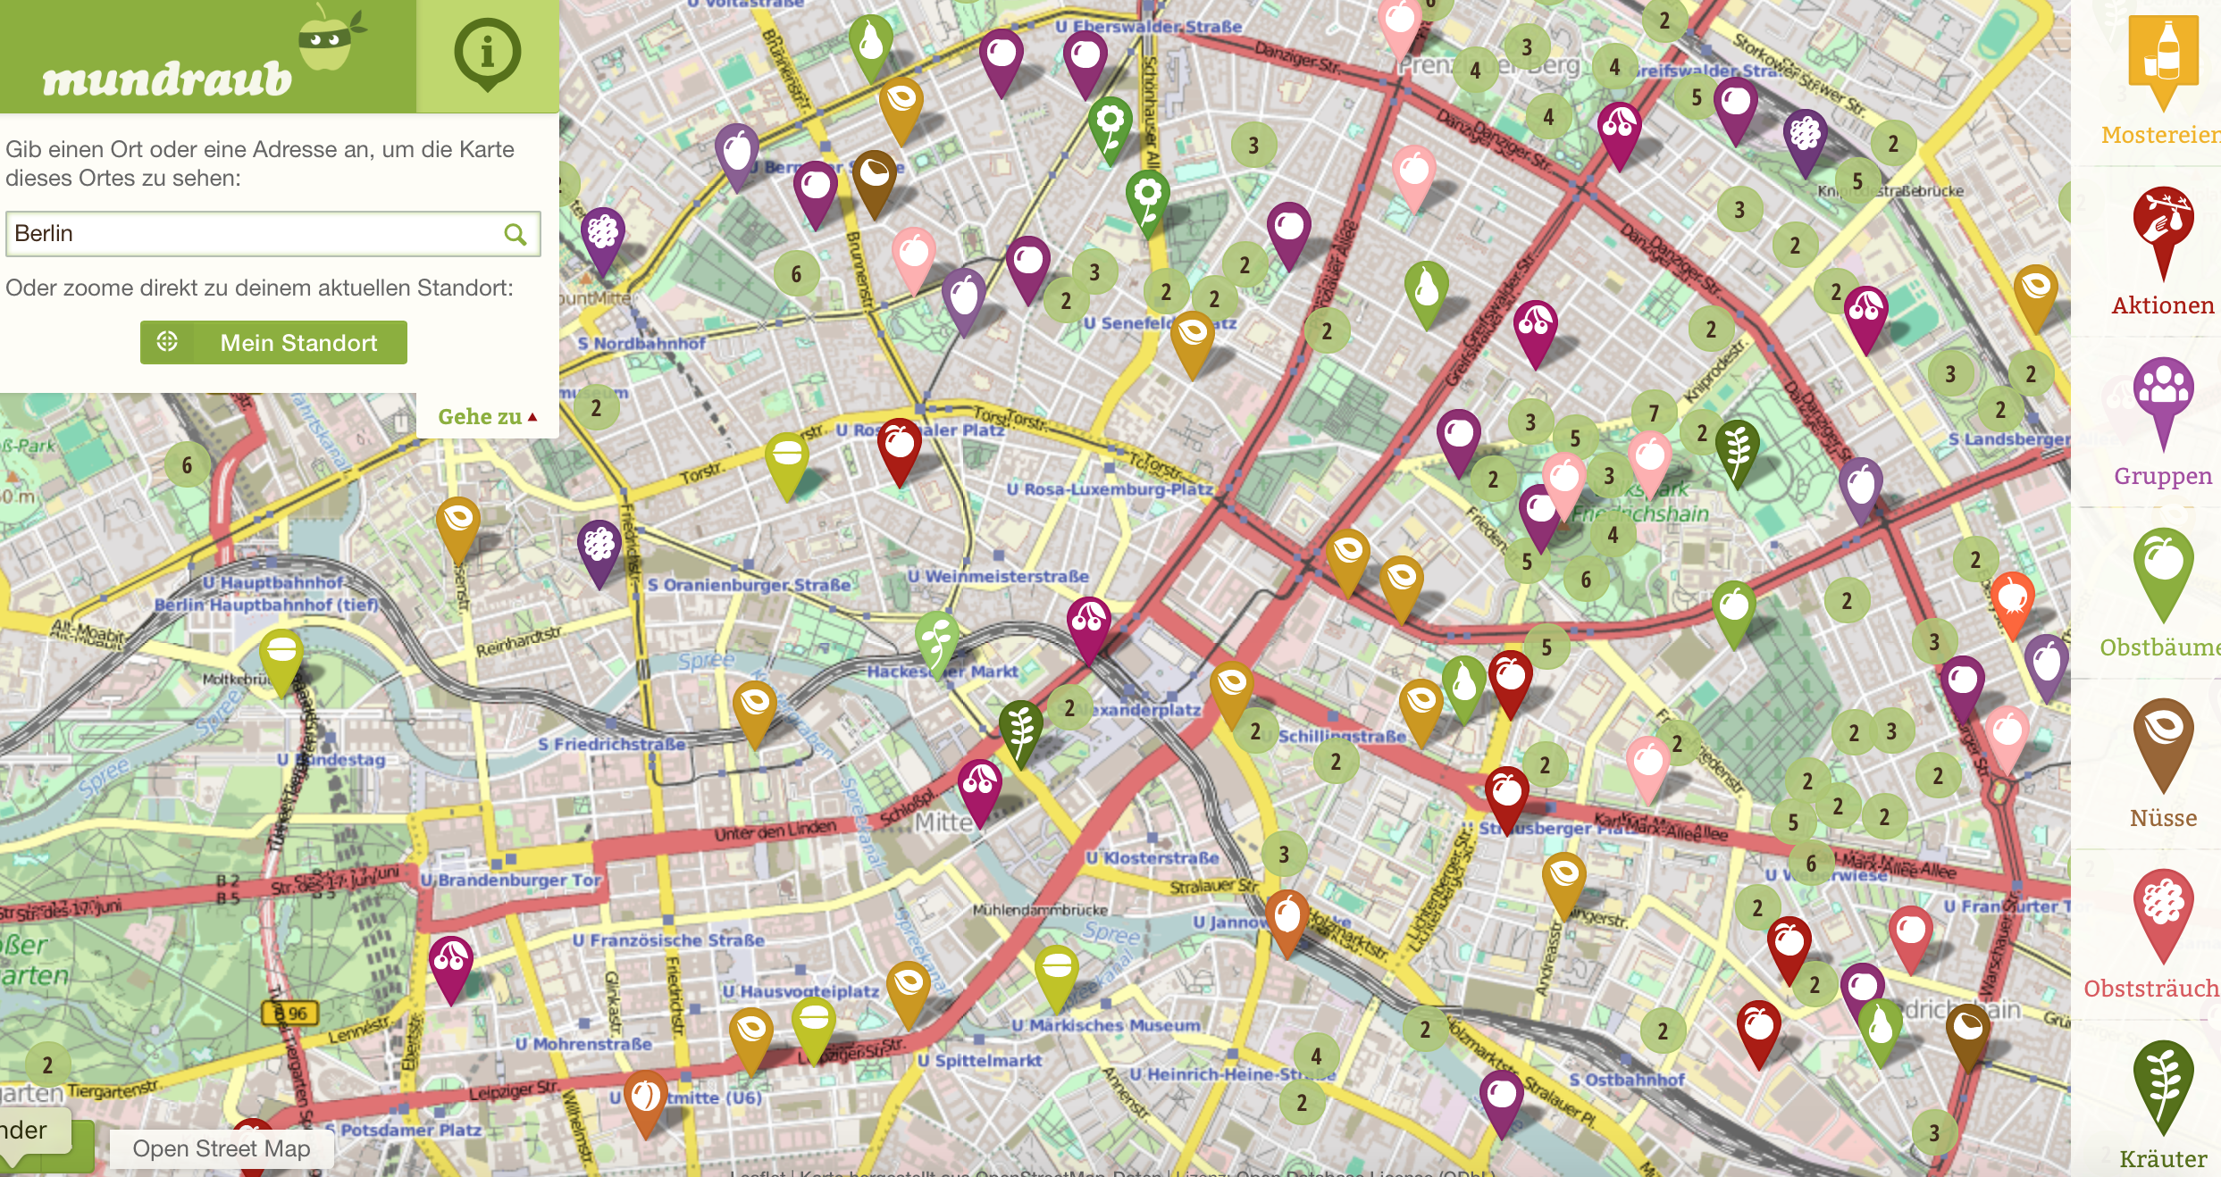
Technologies for Commoning

Slide 42
Next Steps
  In-depth ethnographies and netnographies of food sharing enterprises in 7 cities, 3 satellite cities, and 1 pilot city.
  Developing collaborative relationships with food sharing enterprises.
  Co-Creating sustainability assessment toolkits.

Slide 43
References
Cagle, S. 2014. Finding a true ’sharing economy’ at the dinner table http://www.takepart.com/article/2014/08/21/meal-sharing-services
Counihan, C., & Siniscalchi, V. (Eds.). 2013. Food activism: agency, democracy and economy. New York: Bloomsbury
Davies, A.R. et al. 2016. SHARECITY100 Database, Trinity College Dublin, Ireland. Retrieved from: http://sharecity.ie/research/sharecity100-database/
Gibson-Graham, J.K.(2006). A Postcapitalist Politics. Minneapolis: University of Minnesota Press
Gibson-Graham, J.K., J. Cameron, and S. Healy. 2013. Take Back the Economy. Minneapolis: University of Minnesota Press
Gudeman, S., 2016. Anthropology and Economy. Cambridge University Press.
McLaren, D., & Agyeman, J. 2015. Sharing Cities: A Case for Truly Smart and Sustainable Cities. MIT Press.
Morrow, O., & Dombroski, K. 2015. Enacting a postcapitalist politics through the sites and practices of life’s work’. Precarious Worlds: Contested Geographies of Social Reproduction
Parker, B. and Morrow, O. (forthcoming). Urban Homesteading and Intensive Mothering: (Re) Gendering Care and Environmental Responsibility in Boston and Chicago. Gender Place and Culture
St Martin, K. 2009. Toward a Cartography of the Commons: Constituting the Political and Economic Possibilities of Place. Professional Geographer, 61(4), 493–507.
Trauger, A., & Passidomo, C. 2012. Towards a post-capitalist-politics of food : cultivating subjects of community economies. ACME: An International E-Journal for Critical Geographers, 11(2), 282–303.

Slide 44




Thank you
Julie Graham Community Economies Research Fund

Slide 45
Questions?
morrowo@tcd.ie
www.sharecity.ie

