Slide 1
Food Sharing Activism in London:
a preliminary reflection on collaborative participant observation
Dr Brigida Marovelli
Postdoctoral Research Fellow
Prof Anna Davies
PI SHARECITY www.sharecity.ie @ShareCityIre

Slide 2
Outline
Introducing SHARECITY research project
Case studies in London
Preliminary reflection on collaborative participant observation
Implications and challenges
Final remarks

Slide 3
SHARECITY
SHARECITY is a 5-year research project funded by the European Research Council which is exploring the practice and sustainability potential of city-based food sharing economies.
Aims & Objectives
To establish the significance and potential of food sharing economies to transform cities onto more sustainable pathways
1)
Develop deeper theoretical understanding of contemporary
food sharing
2)
Generate comparative international empirical data about food sharing activities within cities
3)
Assess the impact of food sharing activities
4)
Explore how food sharing in cities might evolve in the future

Slide 4
SHARECITY Research Phases
Complete
September 2015 – December 2016
A. Development of Concepts,
Framework, & Database
•
•
•
•
Identification of 100 Cities Designing Database Searching for initiatives Analysing the database
Currently in Phase B January 2017 – April 2018
In-Depth Ethnographies
Co-Designing Assessment
Integration, Analysis, & Futures
2018 – 2019
2019 - 2020

Slide 5
Sharing
SHARING AS AN EVERYDAY SOCIAL PRACTICE
Sharing a meal with friends and family; sharing a kitchen with colleagues Historically well researched
SHARING ECONOMIES
Stretching contemporary sharing into new spaces and scales
SUSTAINABILITY CLAIMS BUT LIMITED EVIDENCE BASE
“a means to build community, to distribute (and re-distribute) resources more efficiently, to tread more lightly on our environment” (Gaskins, 2010)
SHARECITY INNOVATION
Opening up new research horizons and building evidence of food sharing

Slide 6
What do we mean by food sharing?
Have a portion of FOOD with another or others; [shared consumption]
Give a portion of FOOD to others;
[gifting]
Use, occupy, or enjoy FOOD jointly; [shared use of space & experiences]
Possess an interest in FOOD in common; [shared interest]
Tell someone about FOOD [shared knowledge/skills]
Community gardens, CSAs, soup kitchens, food banks, potluck, meal sharing apps, collective buying schemes, food rescue, cooperatives,
community kitchens, gleaning,
foraging, dumpster diving, land and yard sharing, tool libraries, seed exchanges, food swaps, food education programs, skill shares, fermentation club, urban beekeeping guilds, meetup groups, food mapping sites.

Slide 7
The SHARECITY100 Database
Interactive Searchable Database: www.sharecity.ie/research/sharecity100-database/
Top 10
London | 201
New York City | 185
Melbourne | 144
Berlin | 133
Sydney | 108
Barcelona | 106
Philadelphia | 81
Chicago | 72
Buenos Aires | 70
Vancouver | 68

Slide 8
Case studies in London
OLIO EX
Skip Garden and Kitchen by Global Generation
Be Enriched and Brixton’s People Kitchen
Community Shop

Slide 9
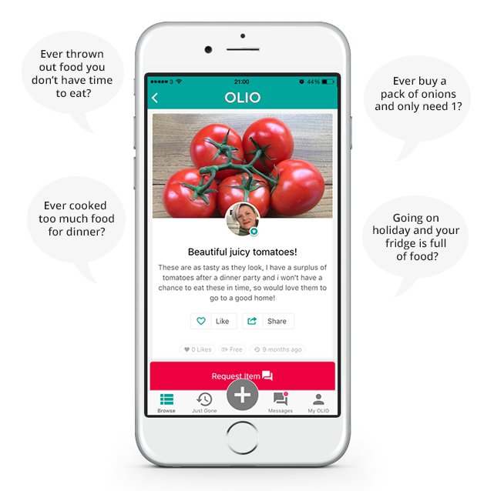
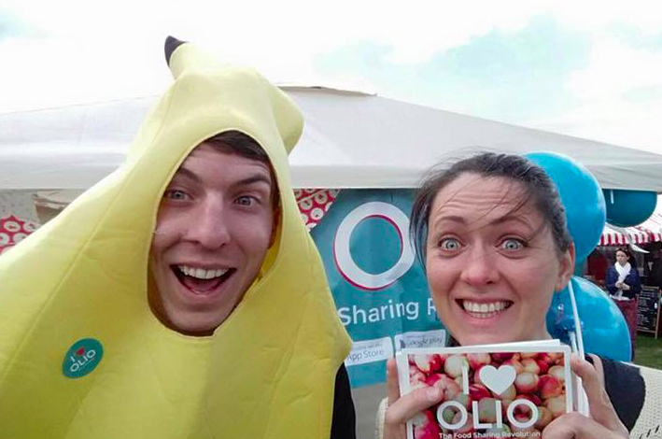

Slide 11
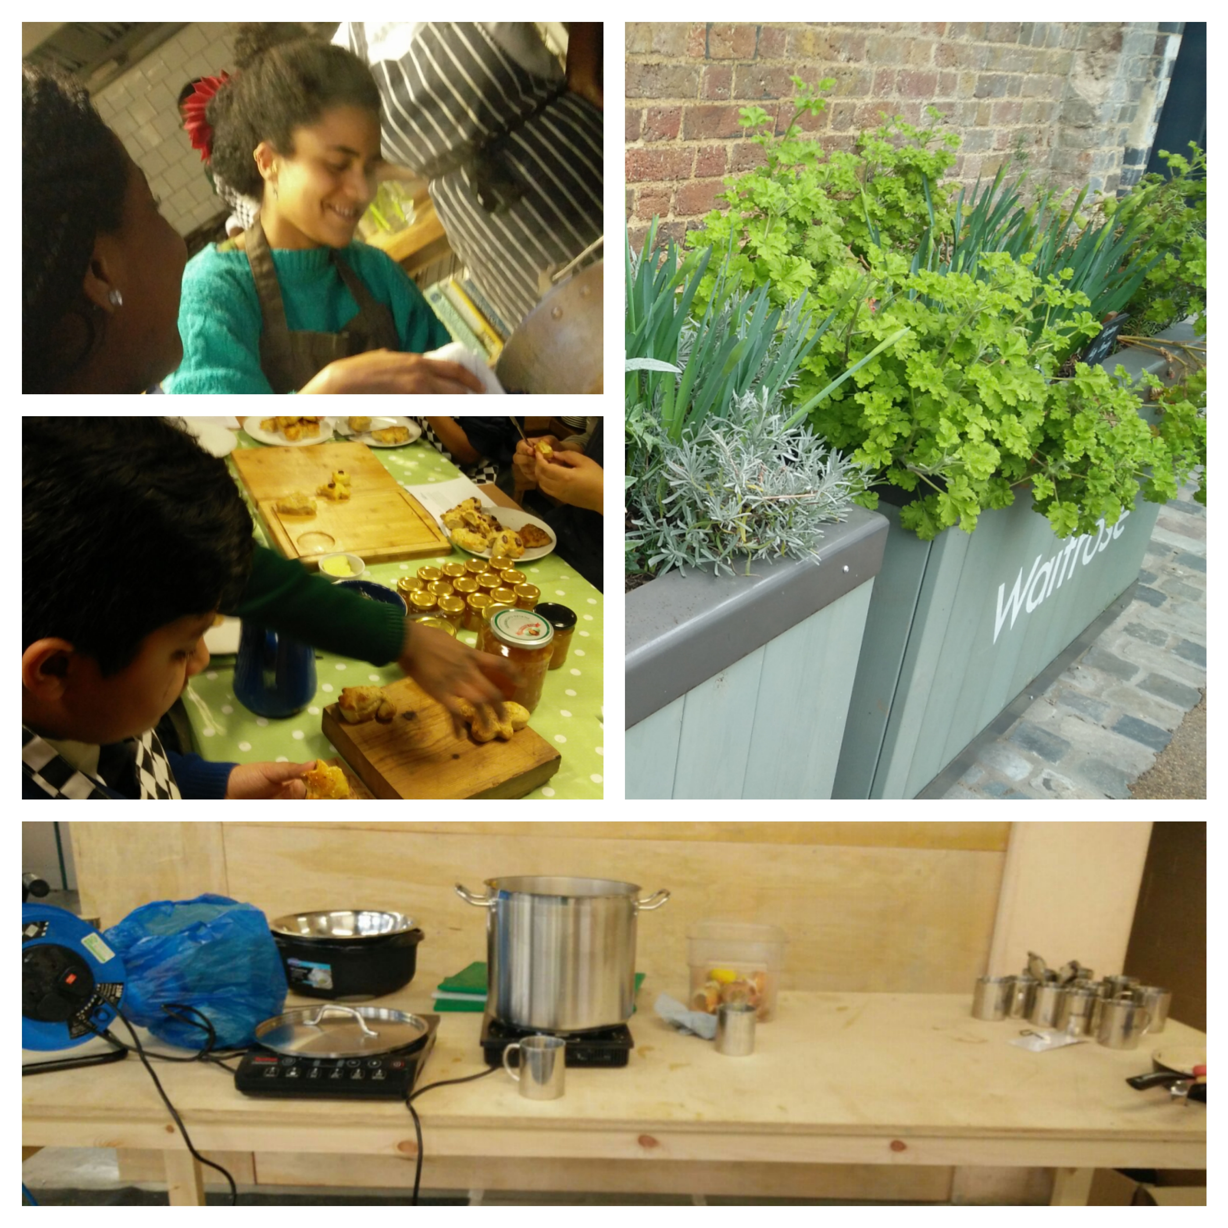

Slide 12
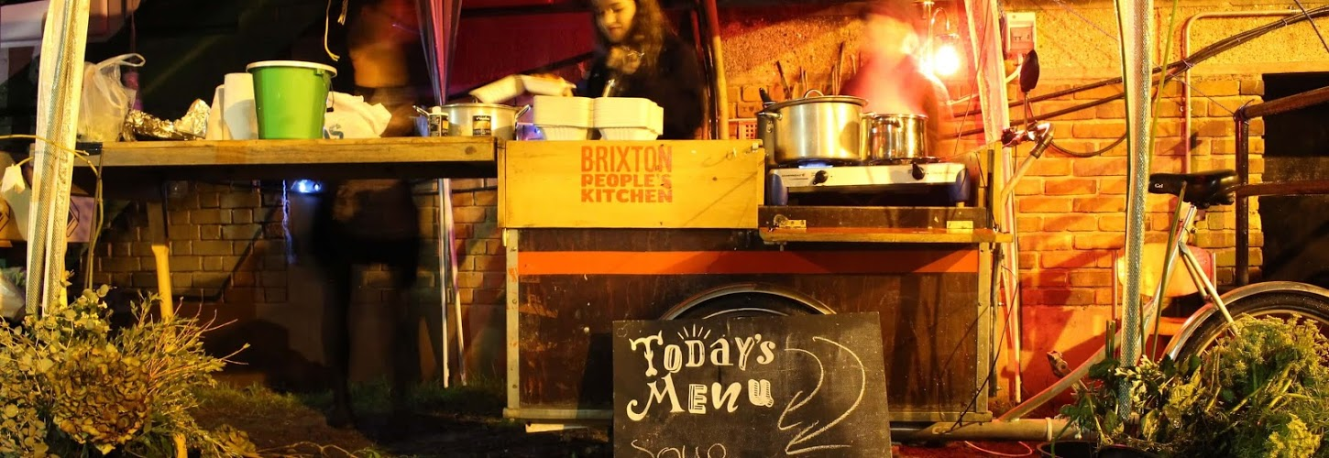

Slide 13
Community kitchens in South London

Slide 14
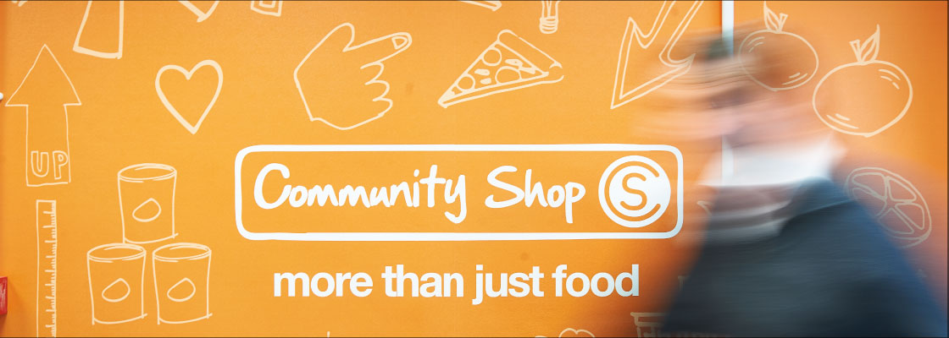
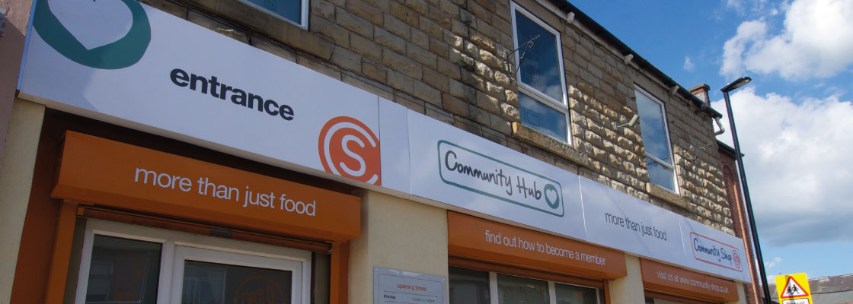

Slide 15
The ethnographer
Ethnography as apprenticeship in my previous fieldwork experience

Slide 16
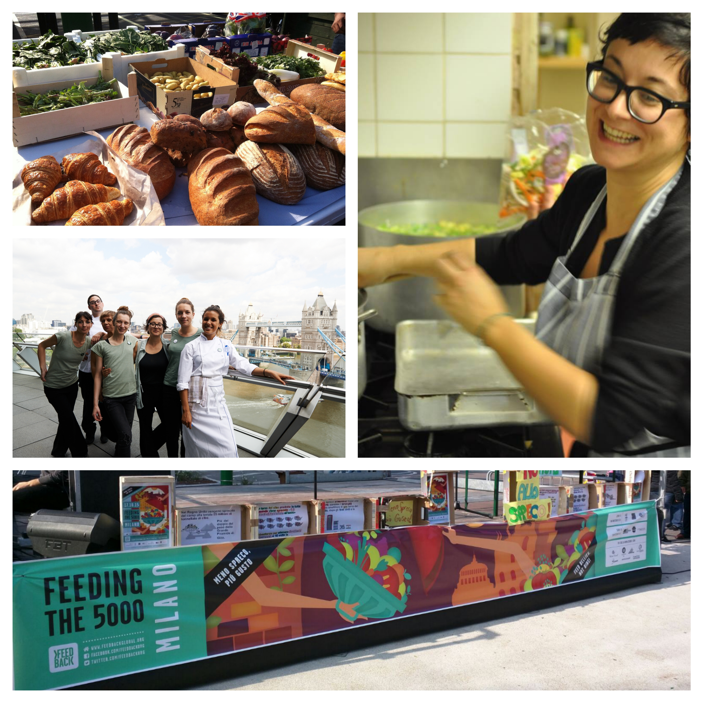
Previous
Experience as
Food Waste Activist
Dinner Exchange London
Disco Soups
Feeding the 5000 Milan

Slide 17
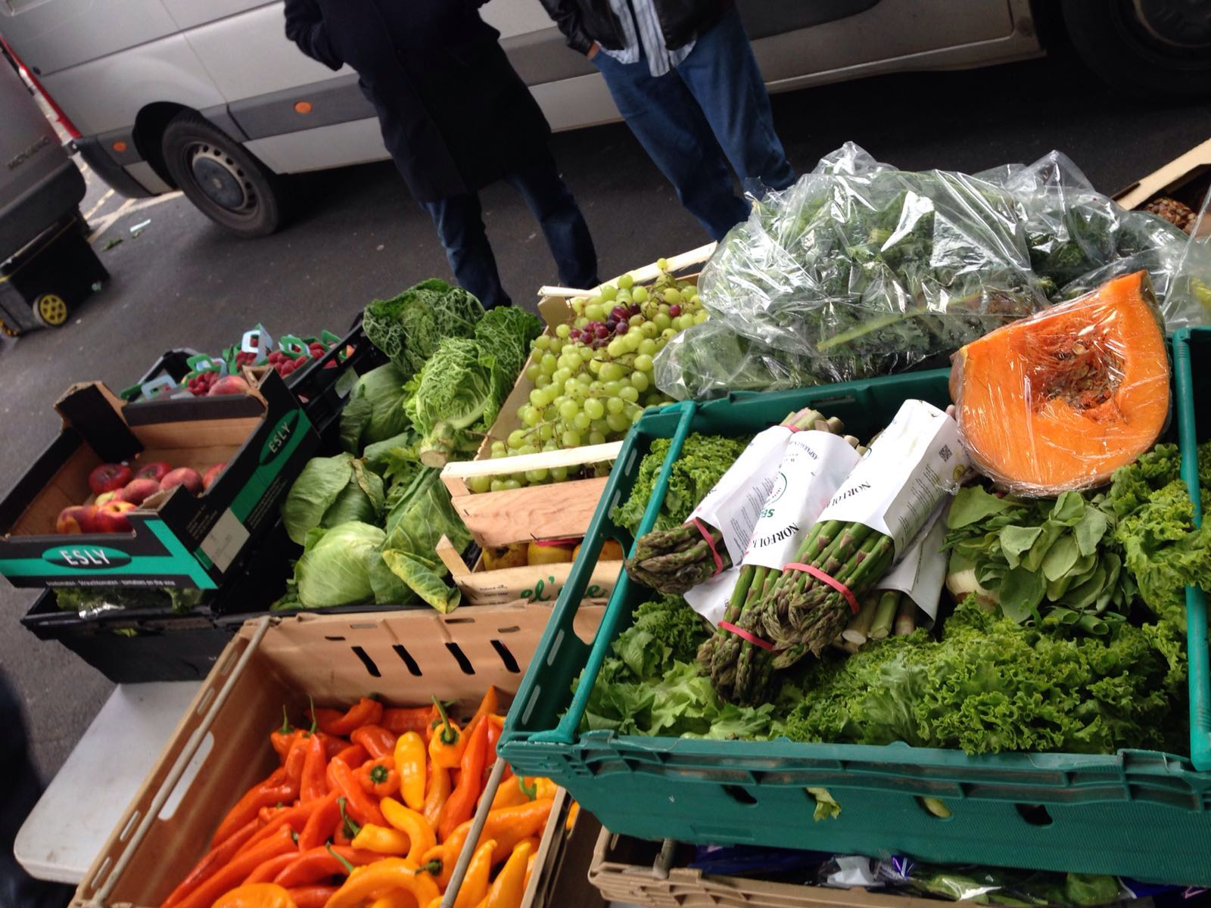
Cooking surplus food in community kitchens
“The last thing a chef wants in a line cook is an innovator, somebody with ideas of his own who is going to mess around with the chef's recipes and presentations. Chefs require blind, near-fanatical loyalty, a strong back and an automaton-like consistency of execution under battlefield conditions”
Anthony Bourdain, Kitchen Confidential: Adventures in the Culinary Underbelly
This definition of a line cook has nothing in common with cooking surplus.
Cooking surplus requires:
Creativity
Flexibility
Imagination
The willingness to improvise with the belief that “”what you have is what you need

Slide 18
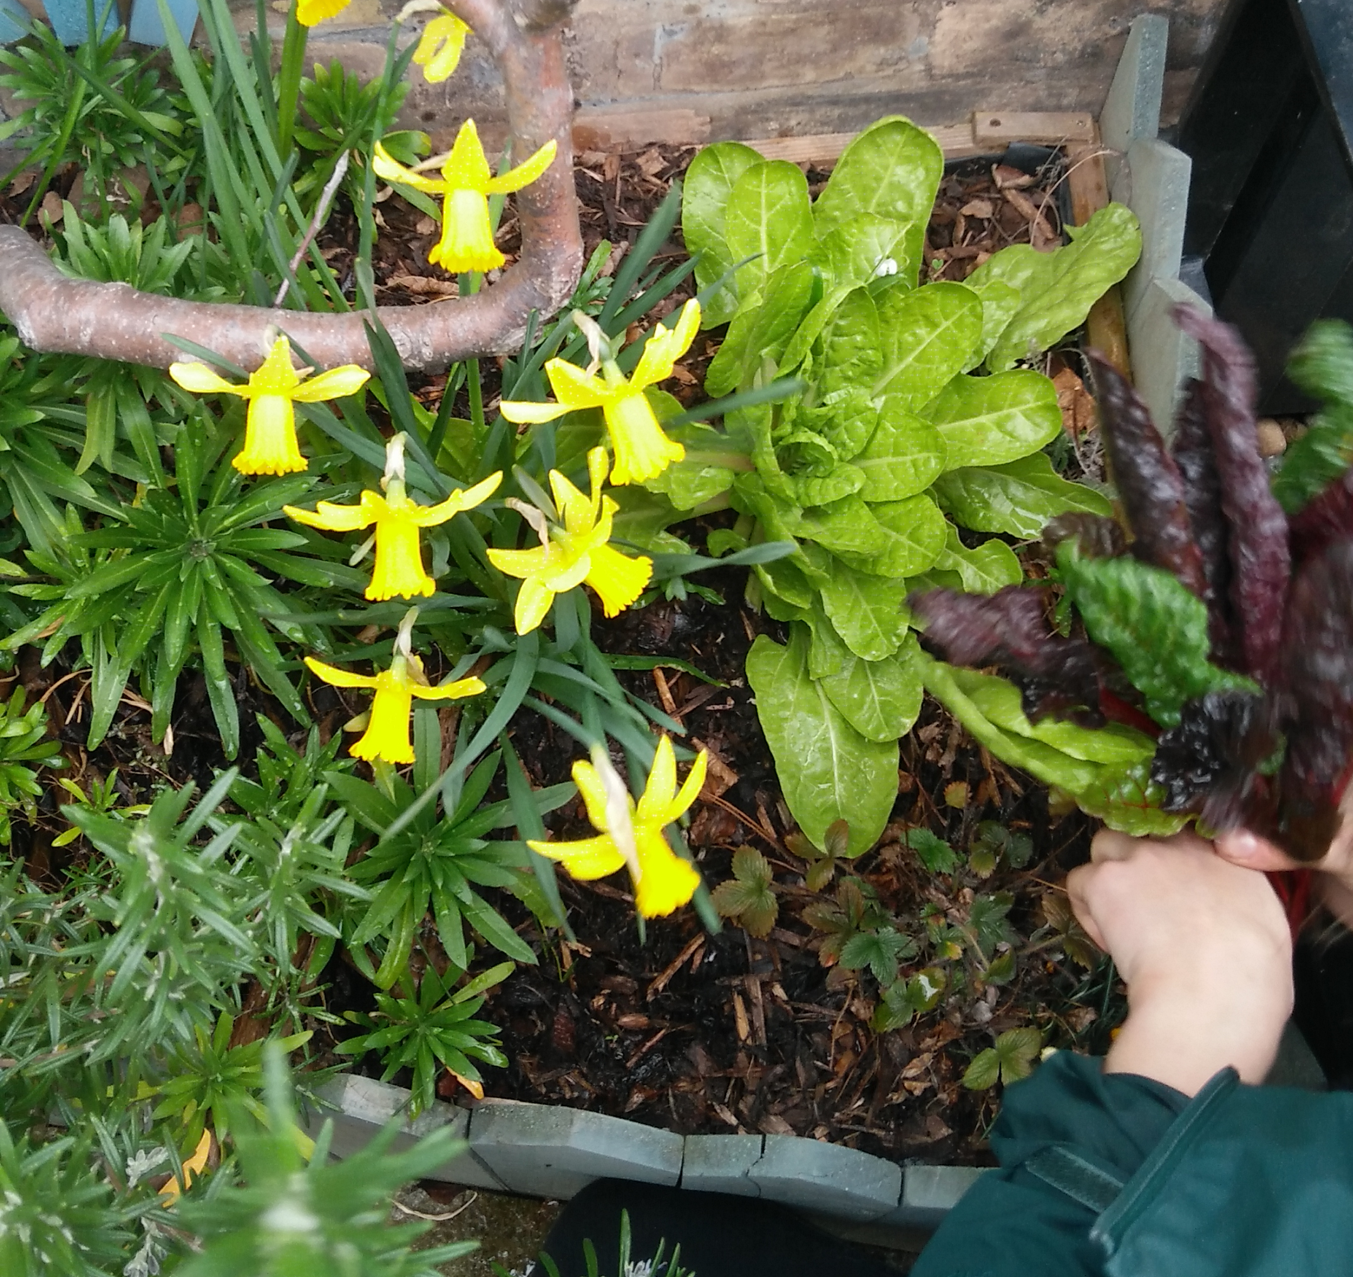
Why collaborative participant observation?
“Collaborative participation presupposes an endeavour of transformation”
(Rabinow and Stavrianakis 2013, 33).

Slide 19
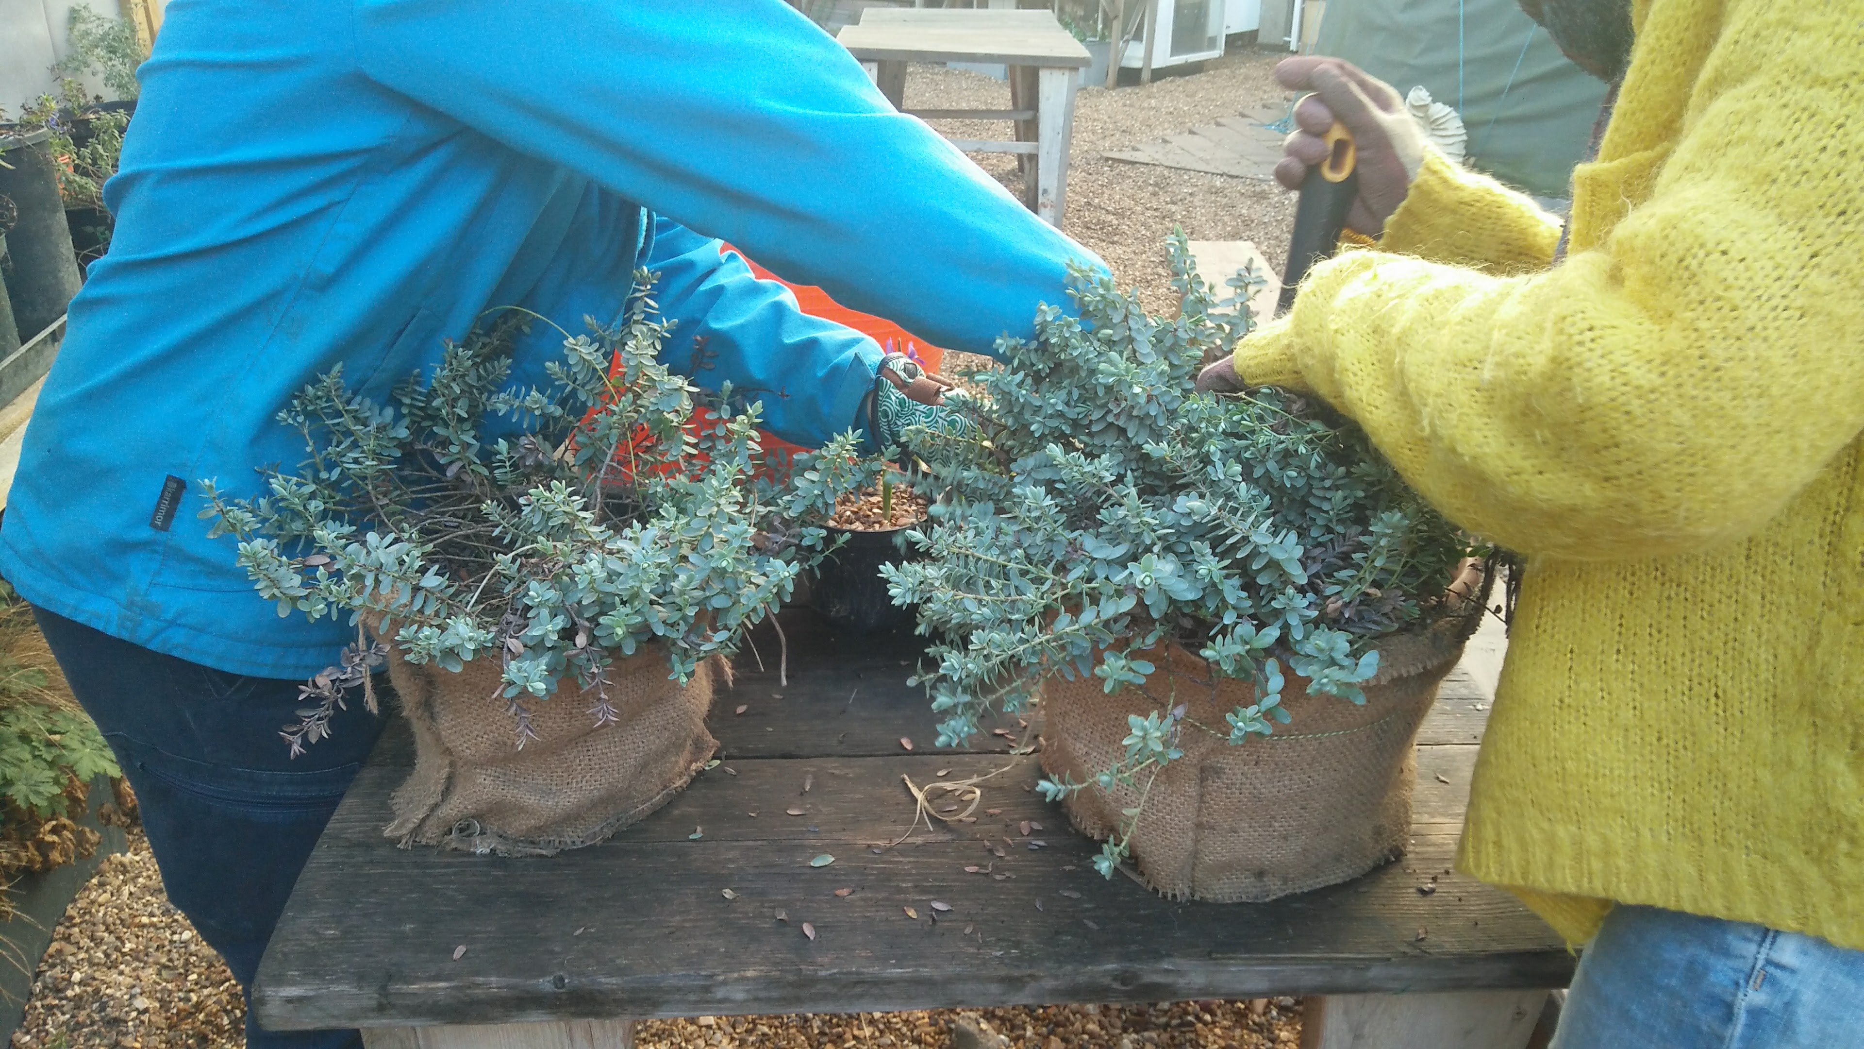
Making our hands dirty: Implications
Ethical concerns
Critical distance
Positionality
Accountability

Slide 20
Challenges
How do we produce work that is “meaningful to the community organizations and struggles with which they work“ while meeting academic standards?
(Urla & Helepololei 2014:446)

Slide 21
Final thoughts on ethnography
"Ethnology is like fishing; all you need is a net to swing, and you can be sure that you'll catch something. Marcel Mauss.
Mauss' words capture something of the open-endedness and possibilities for surprise that anthropological research usually raises. They identify one of the great intellectual pleasures of the fieldwork experience, as well as one of the great methodological strengths of the anthropological tradition. But Mauss' observation also, I have come to appreciate, implies an absence of control that may not be so pleasurable.
The researcher is not in charge and cannot choose what strange and terrible creature may turn up in the net. And when it comes time to inspect the haul, it is not always so clear: did you catch it, or did it catch you? " Ferguson (1999, 17-18)

Slide 22
Thank you!
Dr Brigida Marovelli
marovelb@tcd.ie
@CulinaryActive
Postdoctoral Fellow - SHARECITY School of Geography -Trinity College Dublin Honorary Visiting Fellow Institute for Social Research - Birkbeck University
Prof Anna Davies
PI SHARECITY
www.sharecity.ie
@ShareCityIre

