Slide 1

Sharing Smartly: Food sharing economies in Singapore
Monika Rut
rutm@tcd.ie
www.sharecity.ie

Slide 2
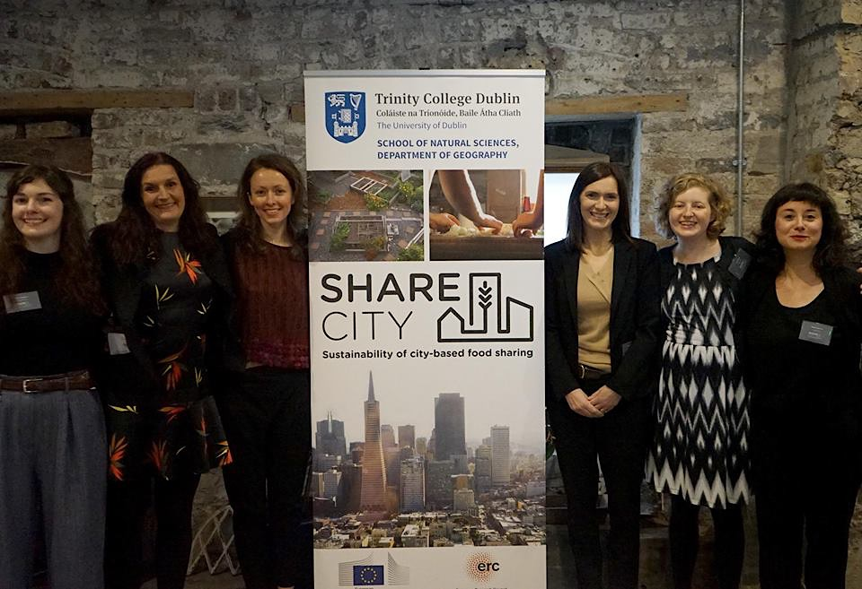

Slide 3
SHARECITY
SHARECITY is a 5-year research project led by Professor Anna Davies (Trinity College Dublin) and funded by the European Research Council which is exploring the practice and sustainability potential of city-based food sharing economies.
Objectives
Develop deeper theoretical understanding of contemporary food sharing
Generate comparative international empirical data about food sharing activities within cities
Assess the impact of food sharing activities
Explore how food sharing in cities might evolve in the future

Slide 4

SHARECITY Research Phases
Development of Concepts, Framework, & Database
    •Identification of 100 Cities
    •Designing Database
    •Searching for initiatives
    •Analysing the database
B. In-Depth Ethnographies
C. Co-Designing Assessment
D. Integration, Analysis, & Futures
Complete
September 2015 –December 2016
Currently in Phase B
January 2017 –April 2018
2018 –2019
2019 -2020

Slide 5
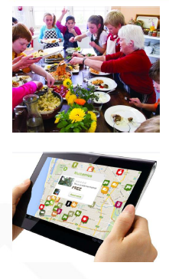
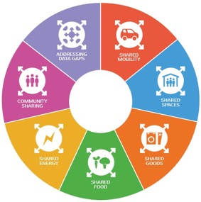
Sharing
SHARING AS AN EVERYDAY SOCIAL PRACTICE
Sharing a meal with friends and family; sharing a kitchen with colleagues; sharing garden with neighbors
SHARING ECONOMIES
Stretching contemporary sharing into new spaces and scales; emerging forms of strangers-sharing
ICT MEDIATED SHARING
New forms of networked sociality; co-creation and co-production models; online communities of practices
SUSTAINABILITY CLAIMS BUT LIMITED EVIDENCE BASE
“A means to build community, to distribute (and re-distribute) resources more efficiently, to tread more lightly on our environment” (Gaskins, 2010)

Slide 6
What is meant by food sharing
Have a portion of FOOD with another or others; [shared consumption]
Give a portion of FOOD to others; [gifting]
Use, occupy, or enjoy FOOD jointly; [shared use of space & experiences]
Possess an interest in FOOD in common; [shared interest]
Tell someone about FOOD [shared knowledge/skills] (OED, 2014)
Our focus is on food sharing activities enabled by information and communications technologies (ICT)
Community gardens, CSAs, soup kitchens, food banks, potluck, meal sharing apps, collective buying schemes, food rescue, cooperatives, community kitchens, gleaning, foraging, dumpster diving, land and yard sharing, tool libraries, seed exchanges, food swaps, food education programs, skill shares, fermentation club, urban beekeeping guilds, meetup groups, food mapping sites

Slide 7
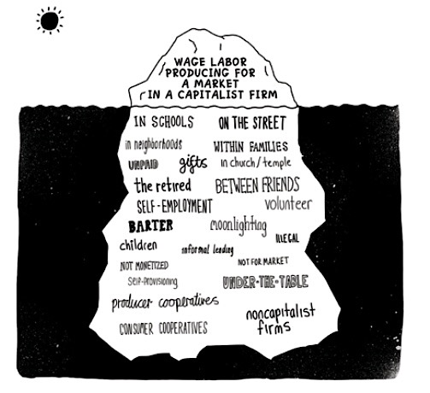
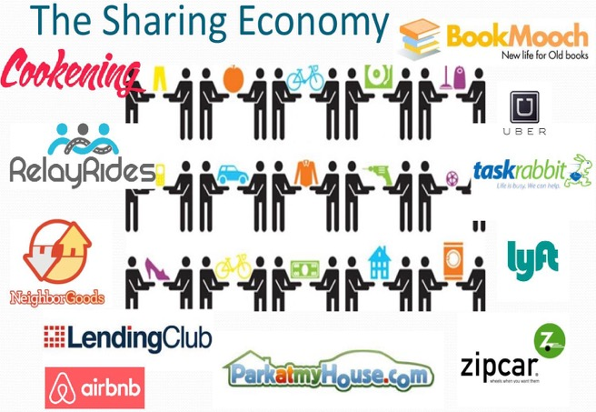
From Sharing Economy to Sharing Economies
(Gibson Graham , 2015)

Slide 8
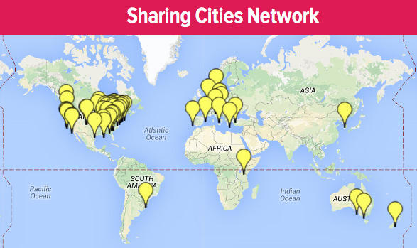
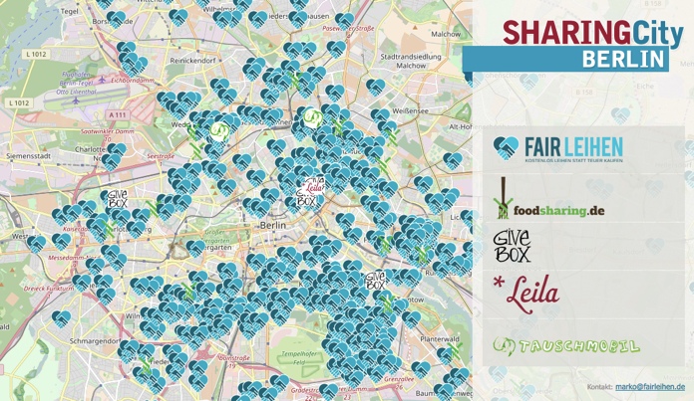

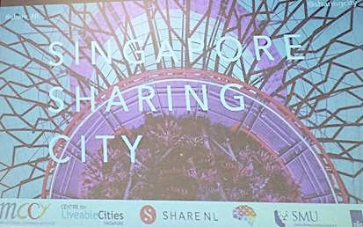
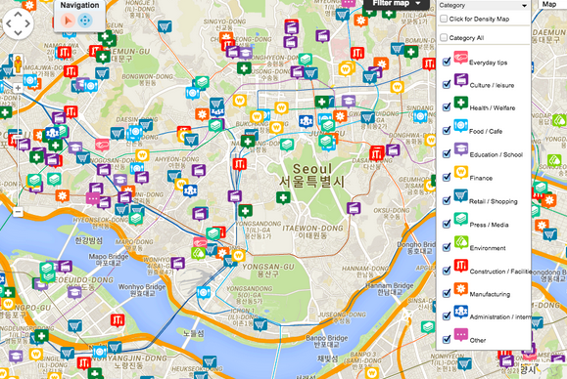
From Smart City to Sharing Cities
(Gibson Graham , 2015)

Slide 9
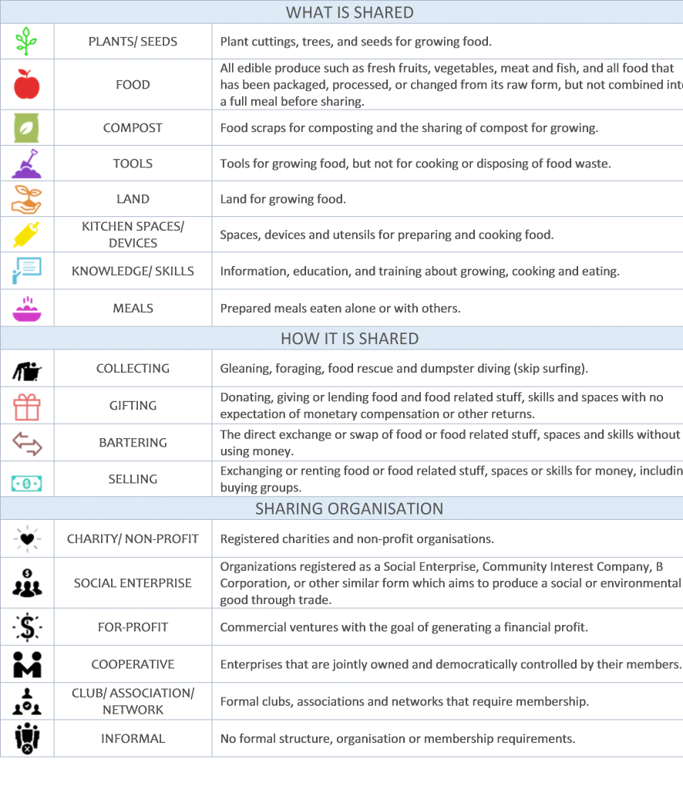

Slide 10
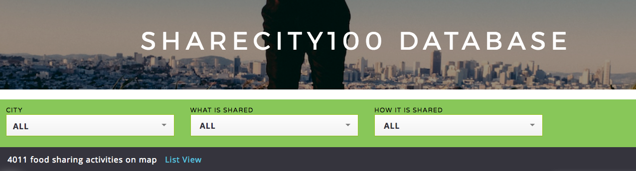
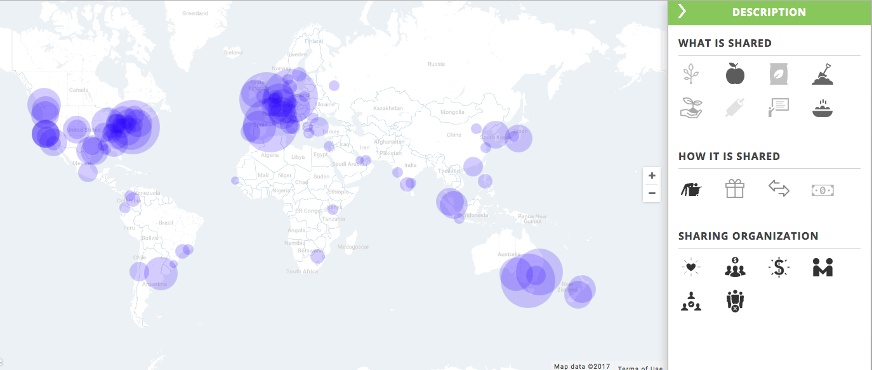
Top 10 Cities
London 198
NYC 188
Melbourne 144
Berlin 137
Sydney 108
Barcelona 107
Philadelphia 82
Chicago 72
Buenos Aires 70
Vancouver 68
http://sharecity.ie/research/sharecity100-database/

Slide 11
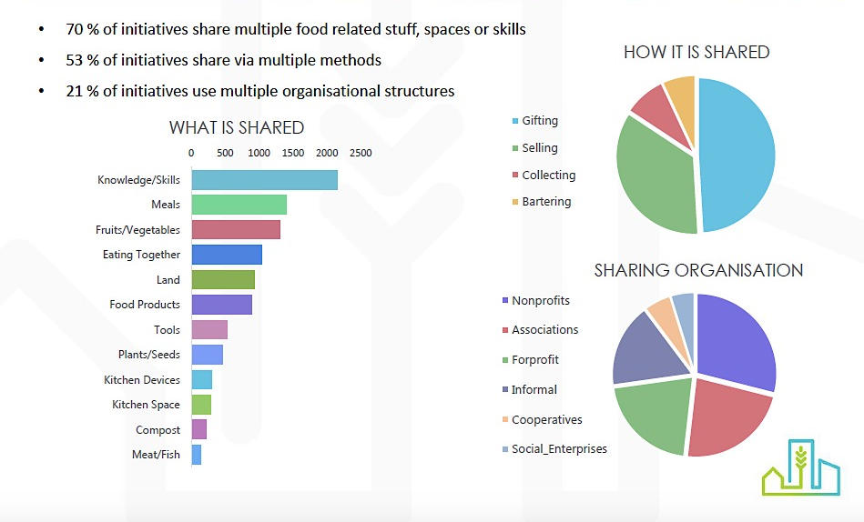
Food Sharing Around the World

Slide 12



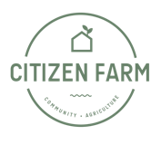





Food Sharing in Singapore
Singapore is ranked #27in the SHARECITY100 Database with 50 food sharing initiatives
80% of food sharing initiatives in Singapore share multiple things. Knowledge & skills are most commonly shared (27%), followed by meals (19%), land and food products (13%)
Selling (43%) is the most common form of food sharing, followed closely by gifting (41%), collecting (5%) and bartering (11%)
For-Profits (37%) and informal ( 27%) are the dominant models of food sharing initiatives followed by non for-profits (17%) social enterprise (8%)

Slide 13
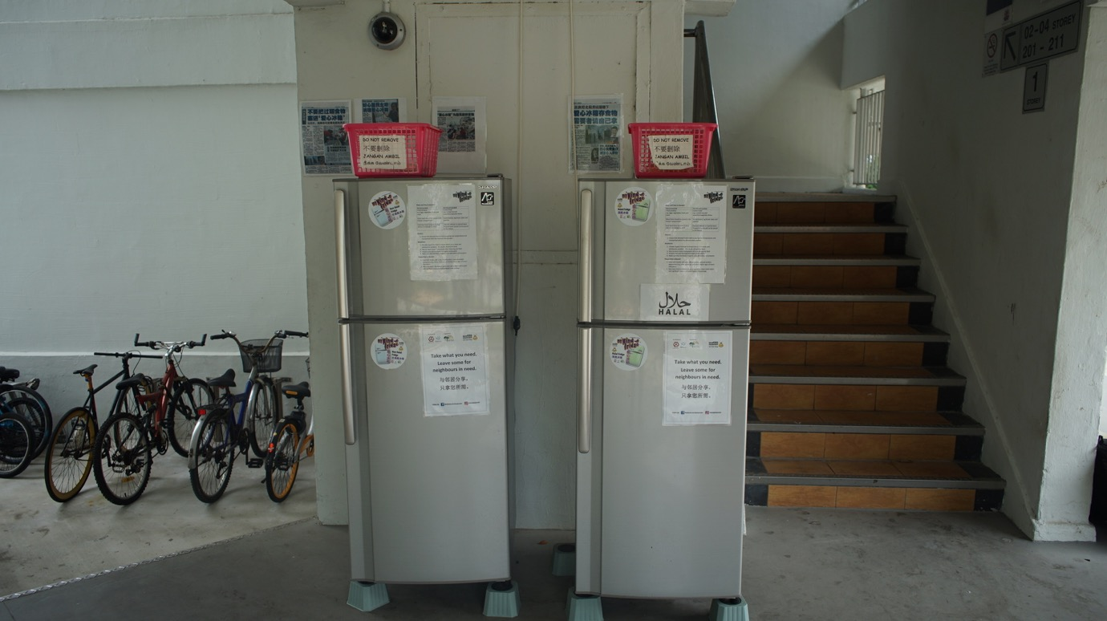
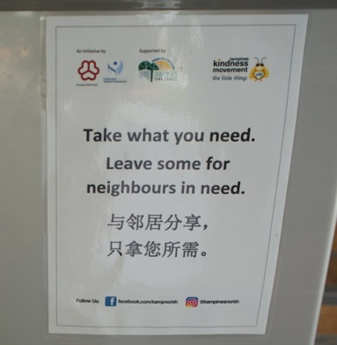
Cooperative behavior?

Slide 14
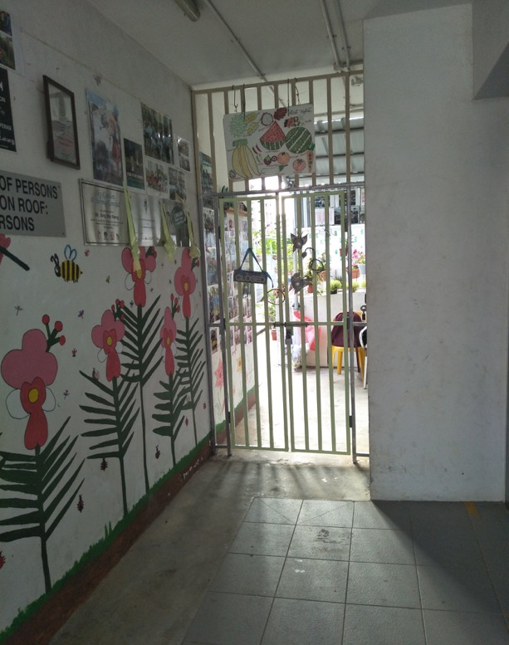
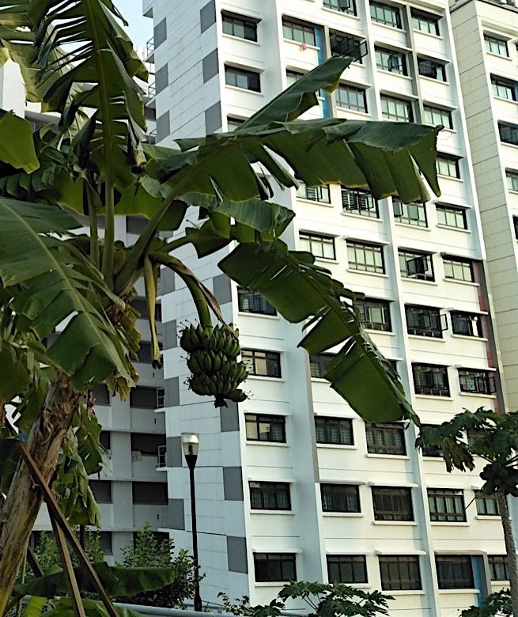
Sharing-in vs Sharing-out

Slide 15
Leading Narratives
City in a Garden, Zero Waste Nation, Smart Nation, Sustainable Singapore
3rd in the world 1st in Asia EIU GFSI 2016
Food affordability (low import tax 1.1%), food availability, high standards for quality and food safety
High imports 90%
Diversification of food supply
Economies of scale
Tech driven solutions in farming and waste management
Eating out, cooking less, western diets, diabetes
Kampong spirit and social cohesiveness
Food is commodity

Slide 16
Emerging Narratives
Grow Your Own Movement, Thinking Edibly, Community Agriculture, Social and Environmental Entrepreneurship
Community food resilience
Diverse food sharing practices (community gardens, communal kitchens, dumpster diving, foraging, seeds and plants swapping, home cooked platforms etc.)
Diverse economies of food systems
Food system obesity
Knowledge commons and crowdsourcing
Aspects of care, individual ownership, mindset-shift
Right to healthy and nutritious food

Slide 17
Policy Consideration
Food sharing is weakly-regulated
NEA, AVA, LT, SLA, MND, MSF, HDB, URA, HPB, Nparks
Business disruptive trends
Community informed practices
Permanent transformations and sense of “temporariness”

Slide 18




Slide 19
Food Sharing and Food Production
Land, water, climate constraints
Land sharing, underutilized spaces, resources sharing
Food production vs community bonding
Agritainment & aestheticization of farming
Are the consumer ready yet?

Slide 20
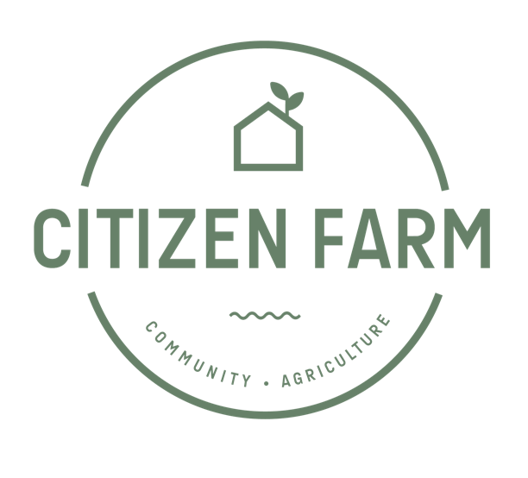

Slide 21
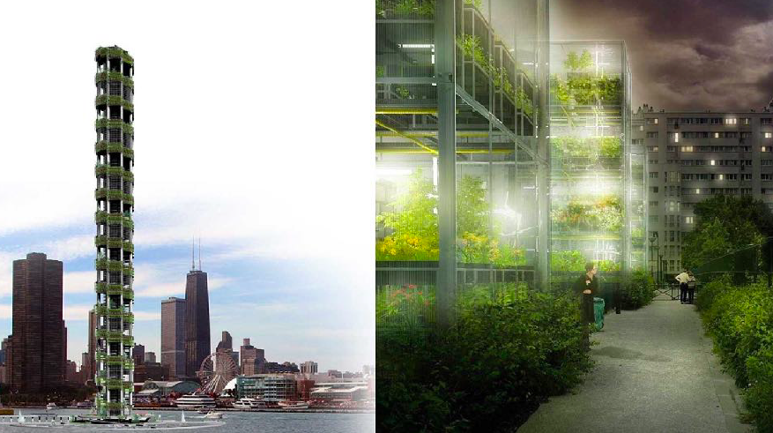

Slide 22
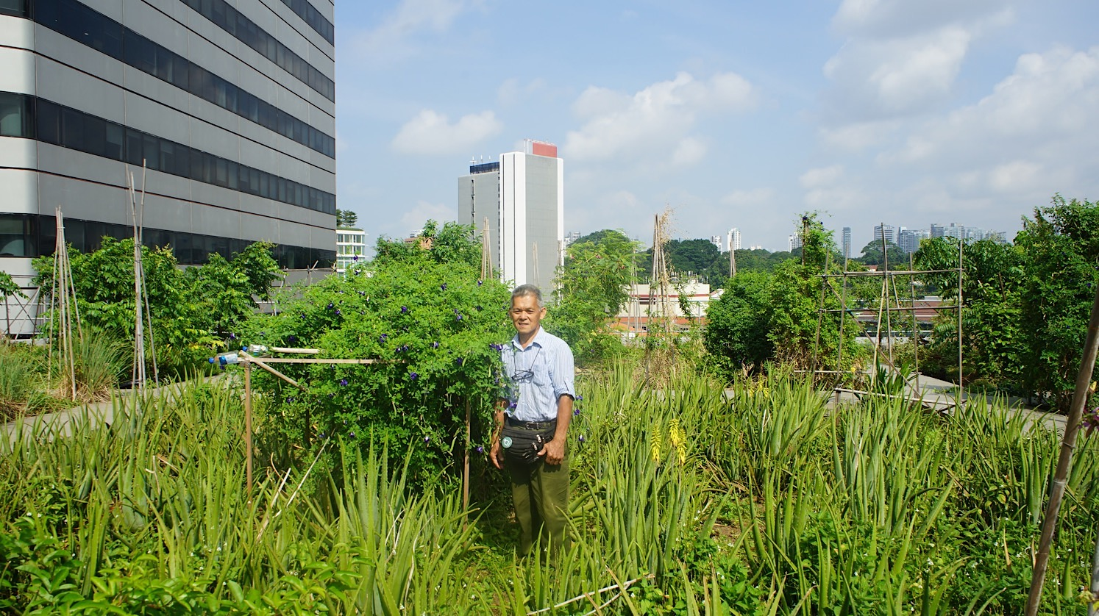

Slide 23
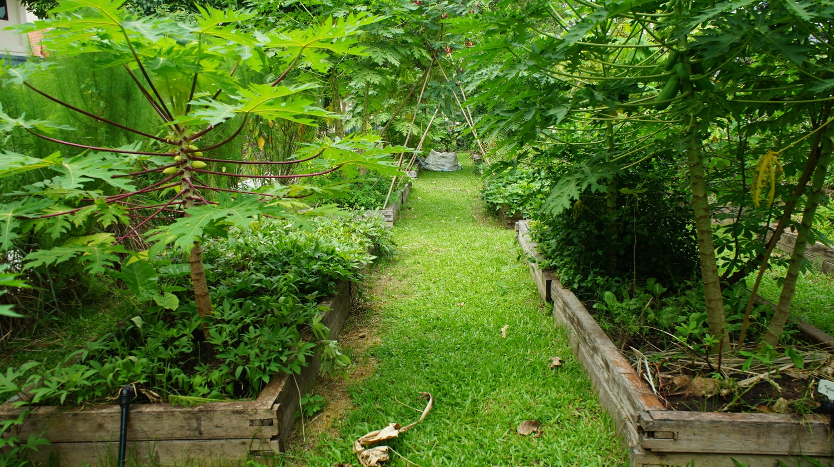

Slide 24
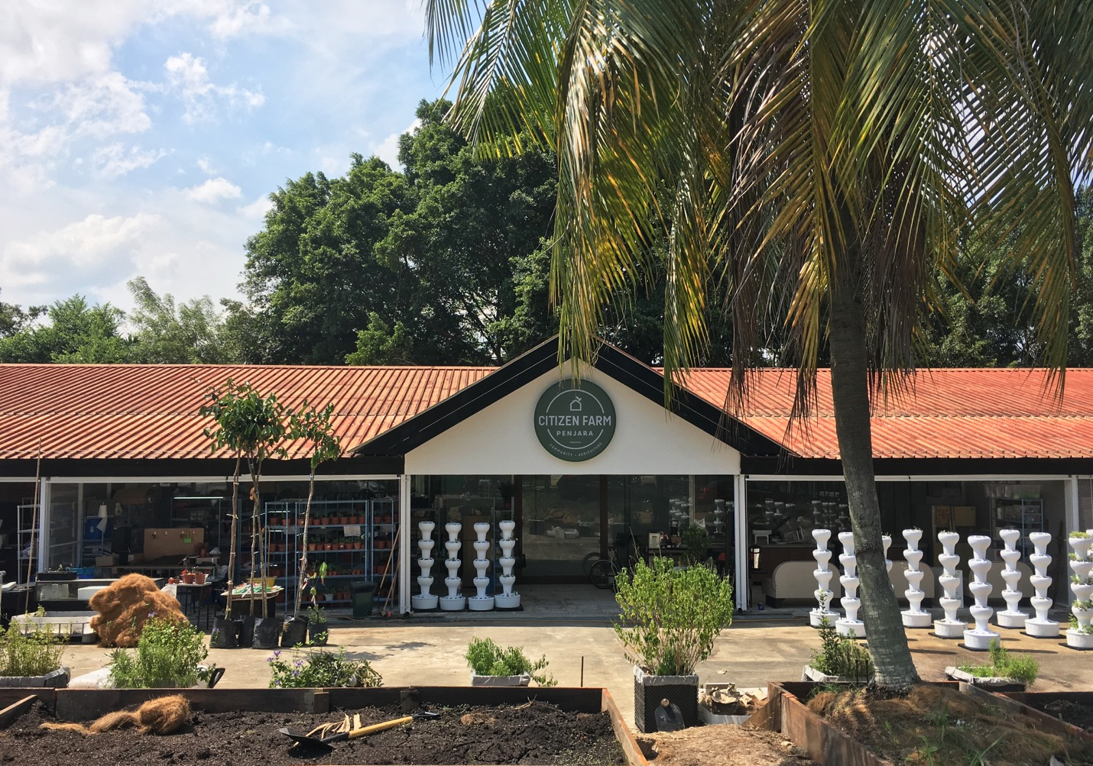

Slide 25
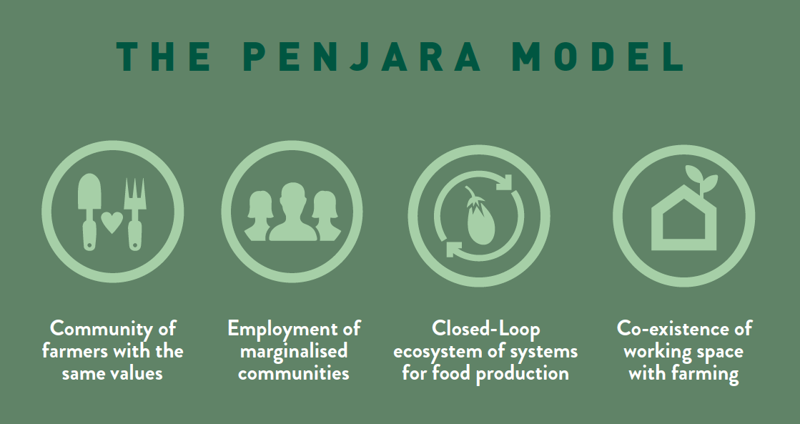

Slide 26
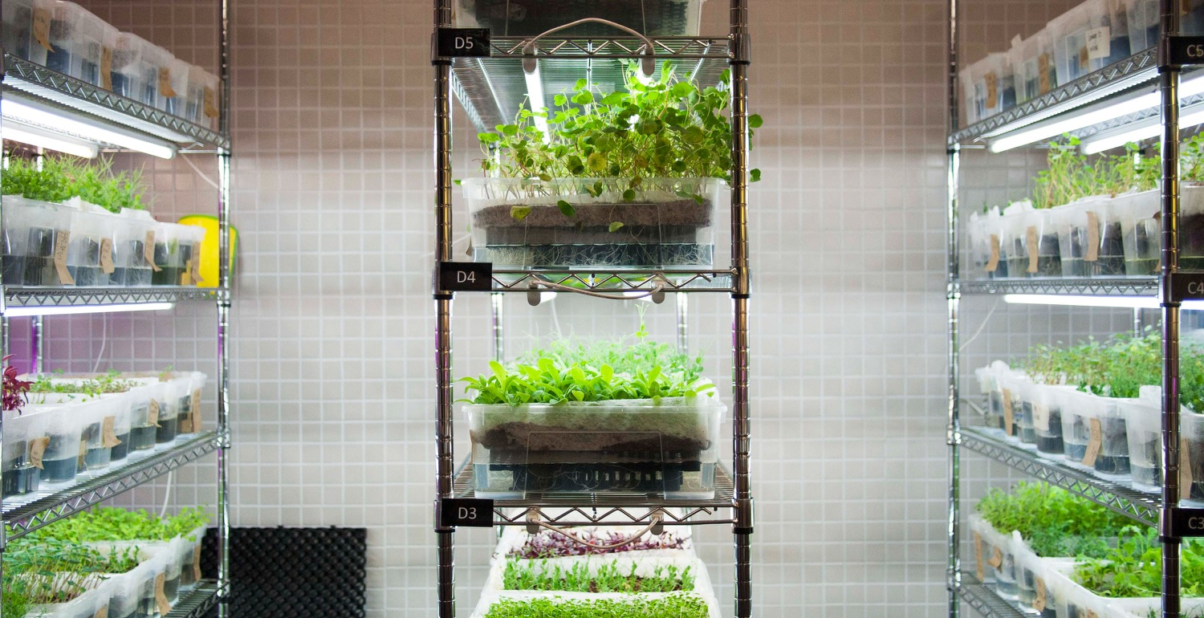

Slide 27
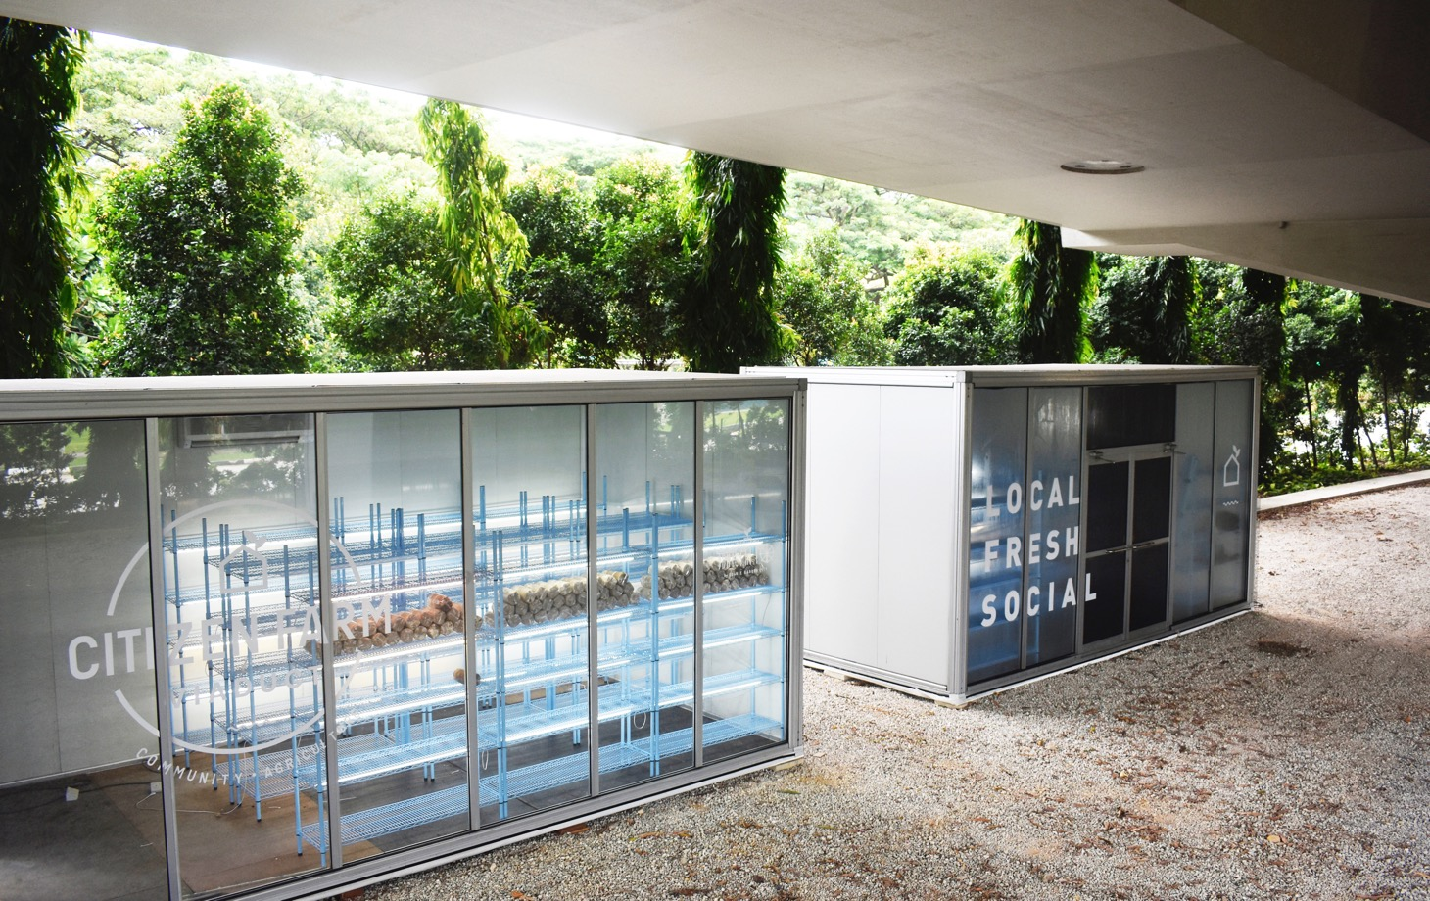

Slide 28
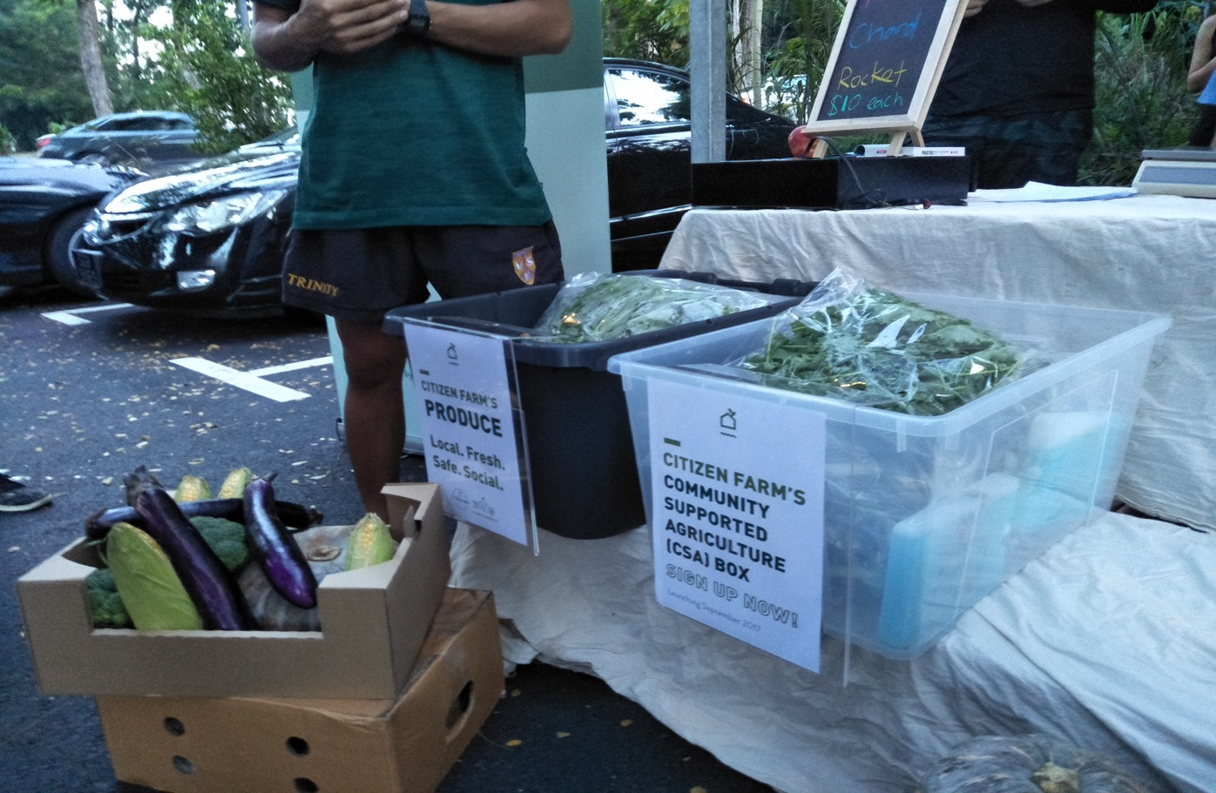

Slide 29
Some considerations
Scaling space, skills, stuff, knowledge and technologies ( HDBs, offices, community gardens, underutilized spaces, neighboring countries etc.)
Urban farming model for Singapore?

Slide 30
Food Sharing and Food Consumption
Dah makan belum?
Culinary knowledge & consumption habits
Mom & retiree entrepreneurship
Shared use of kitchens
Sharing food vs selling food
Disruptive trend?

Slide 31
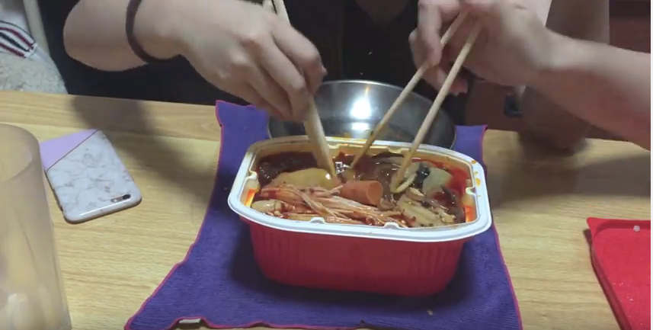

Slide 32
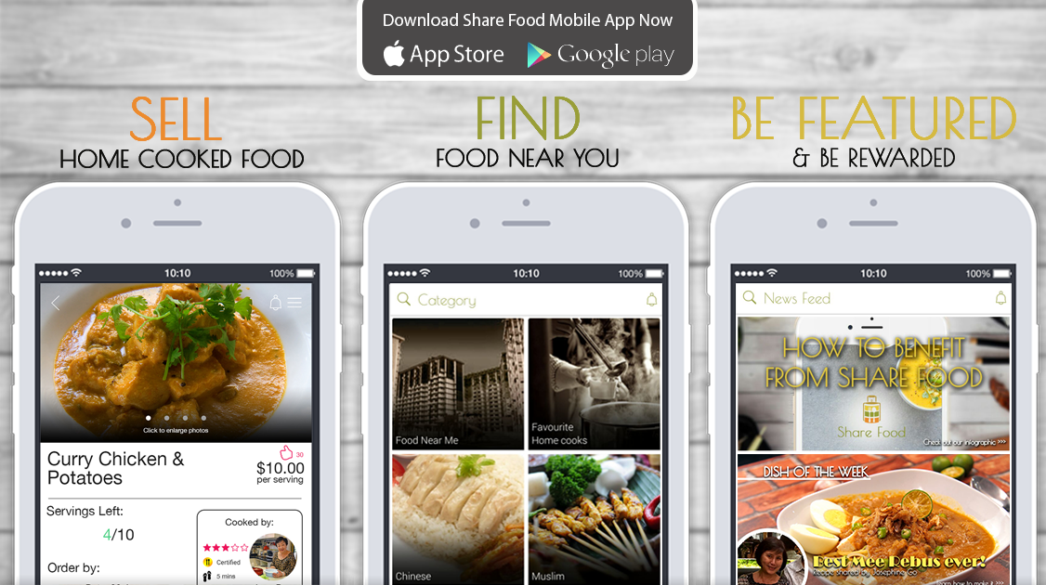

Slide 33
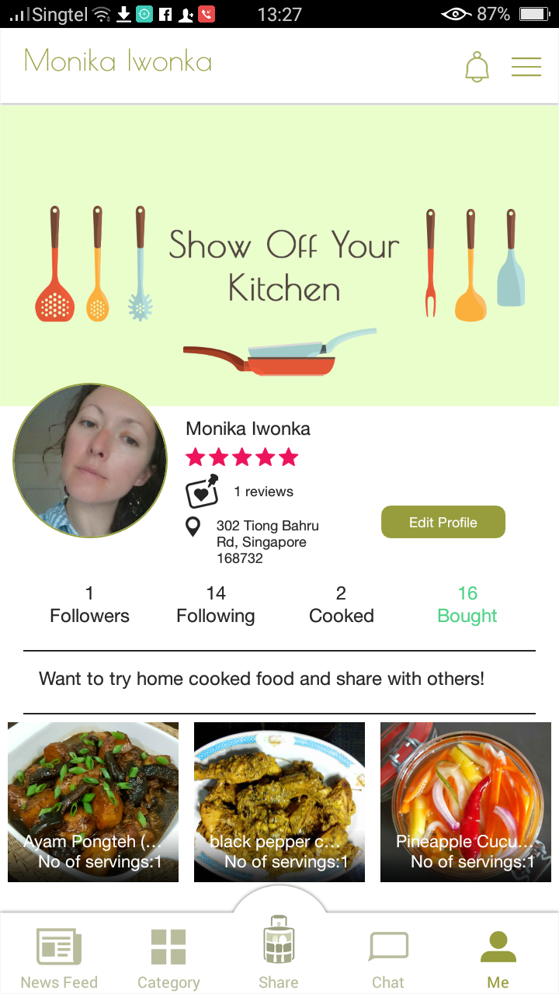
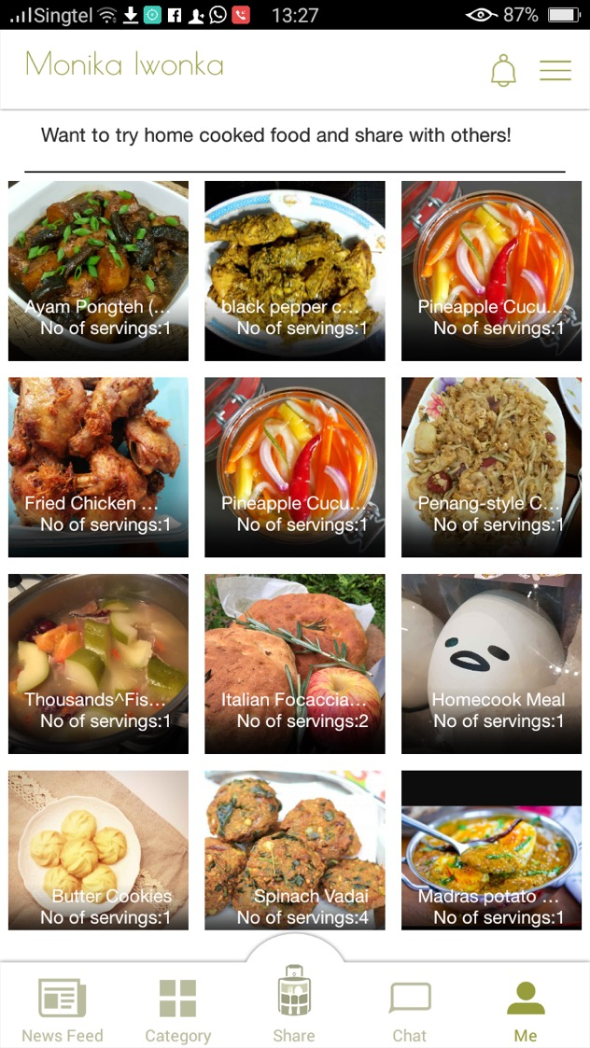

Slide 34
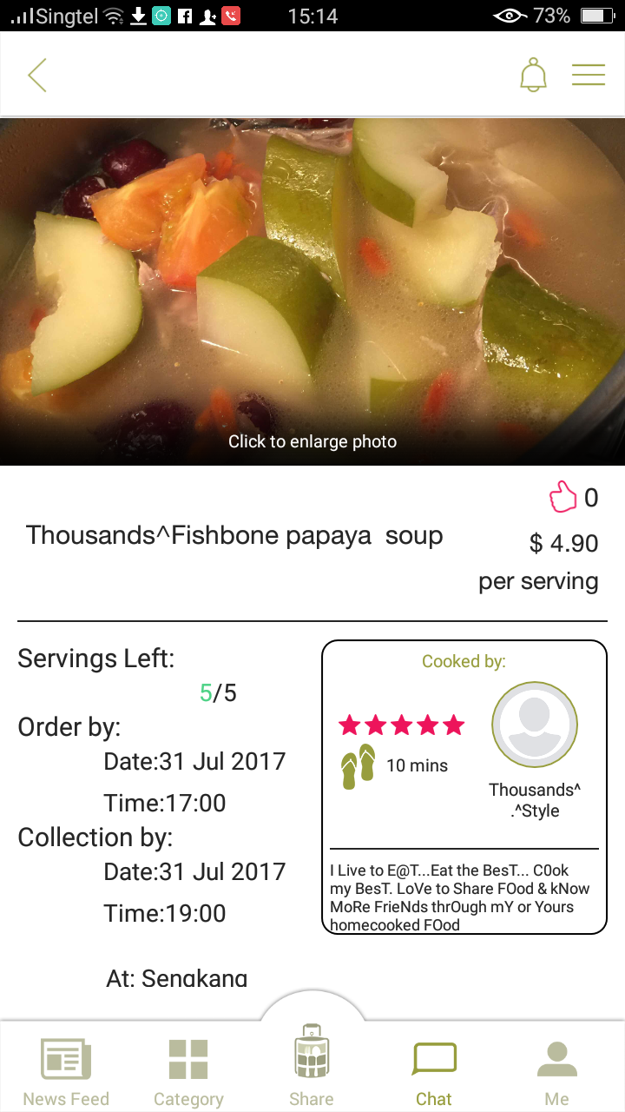
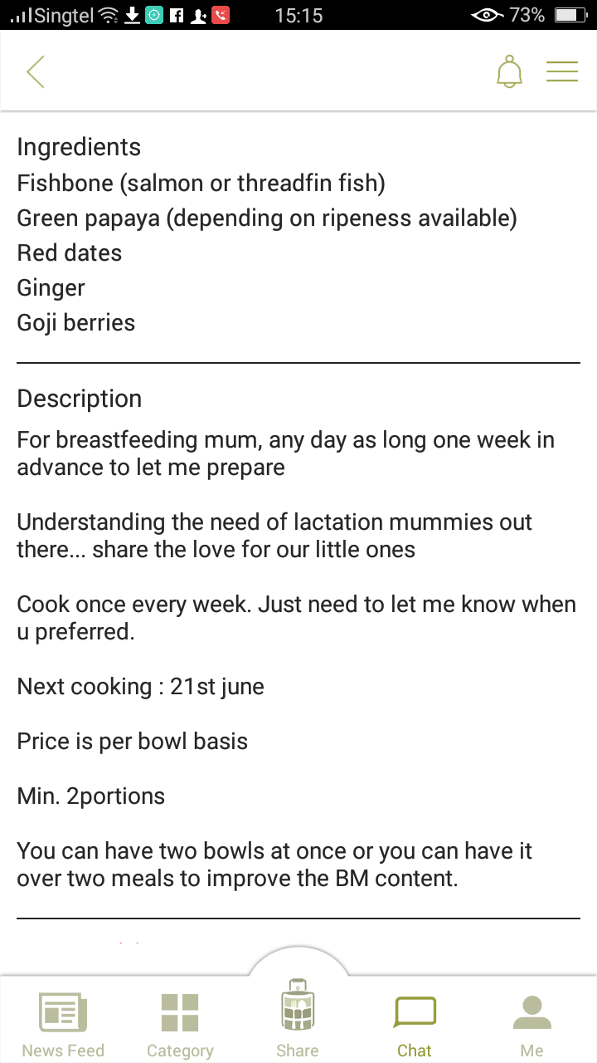

Slide 35
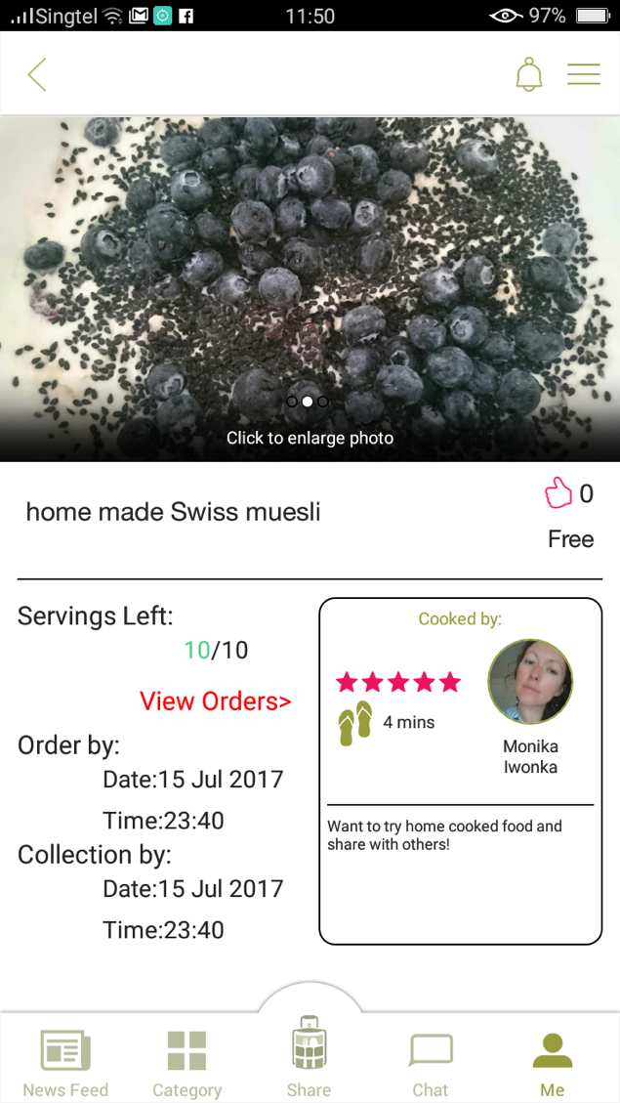
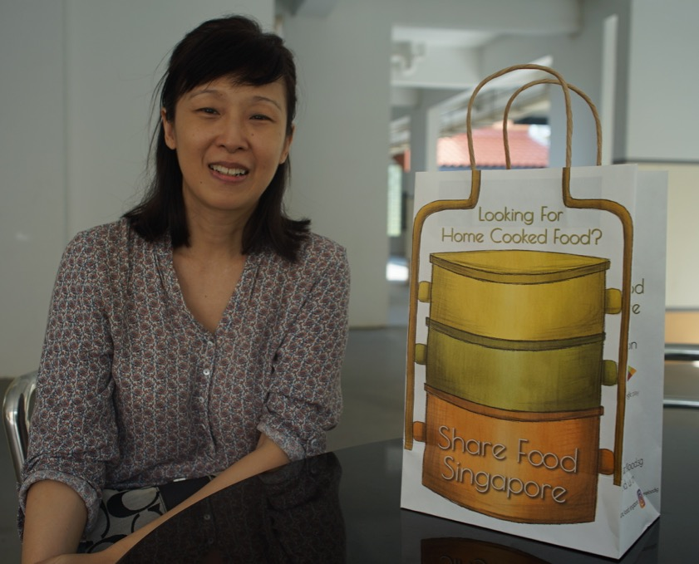

Slide 36
Some considerations
Regulatory frameworks for sharing home-cooked and perishable foods
Preserving heritage dishes, family recipes and memories
Home chefs neighborhoods?

Slide 37
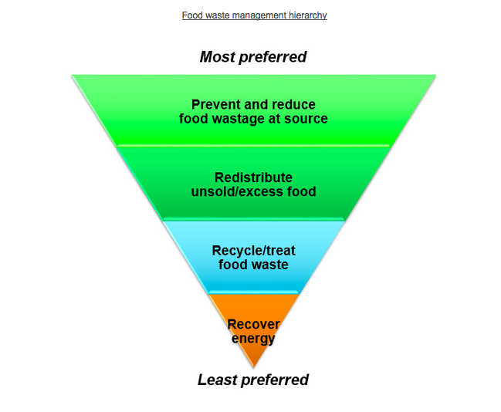
Food Sharing and Excess Food
Source:NEA

Slide 38
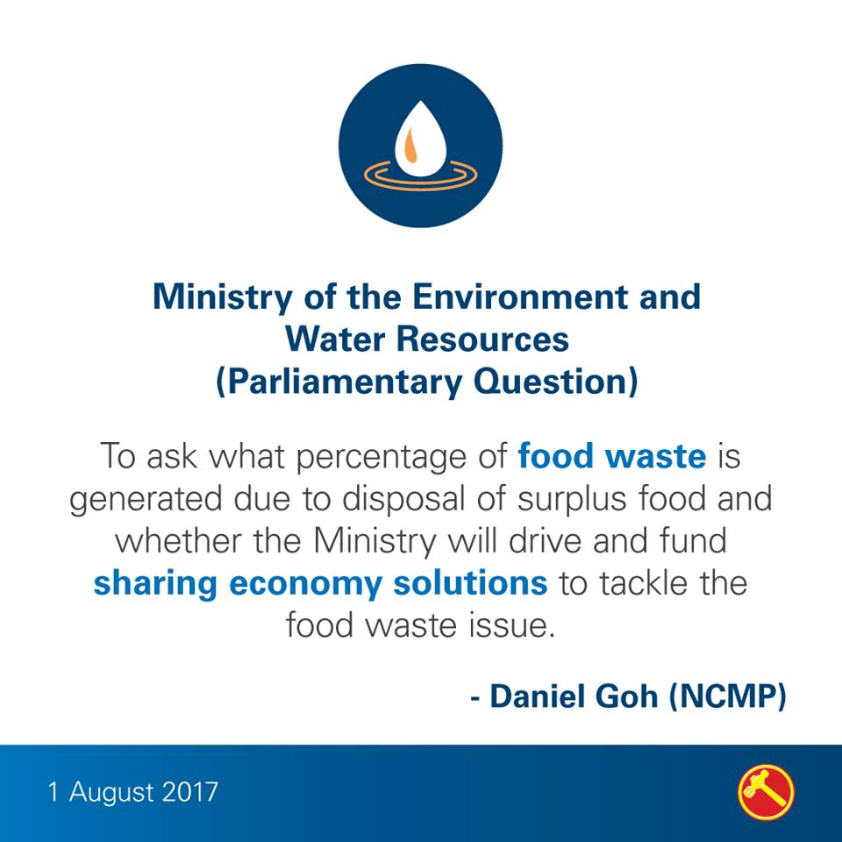

Slide 40
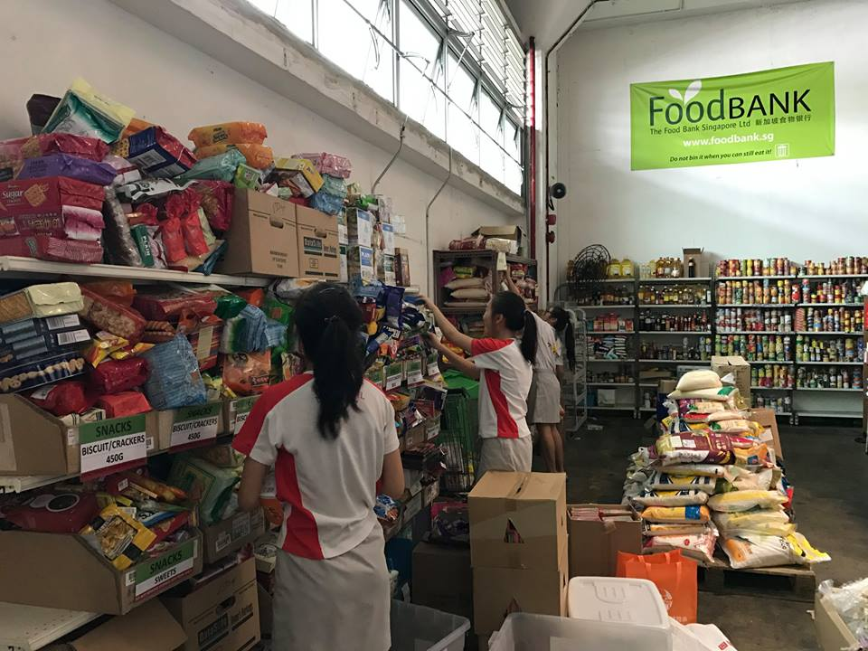

Slide 41
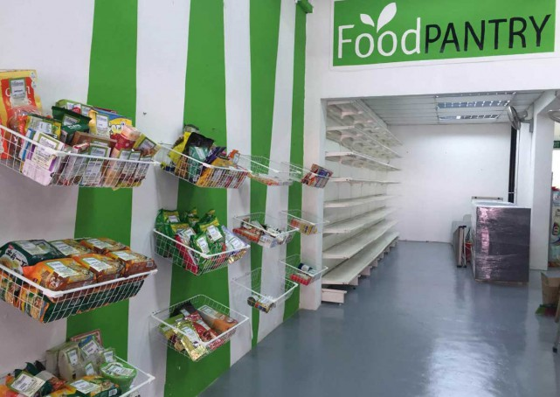

Slide 42
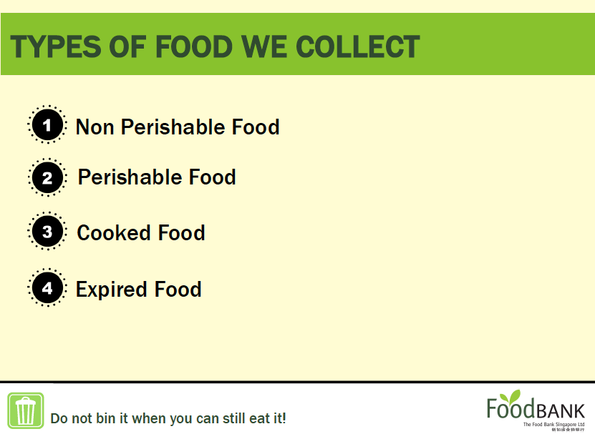

Slide 43
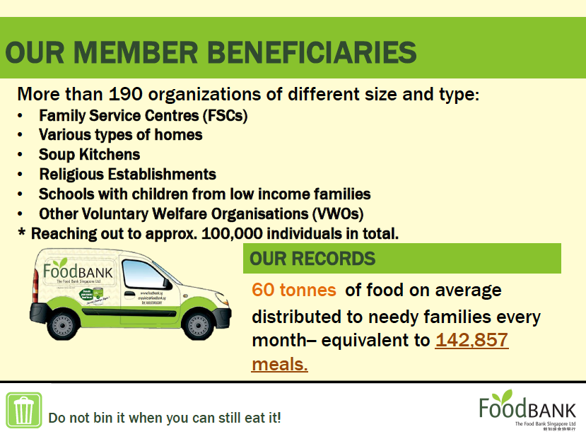

Slide 44

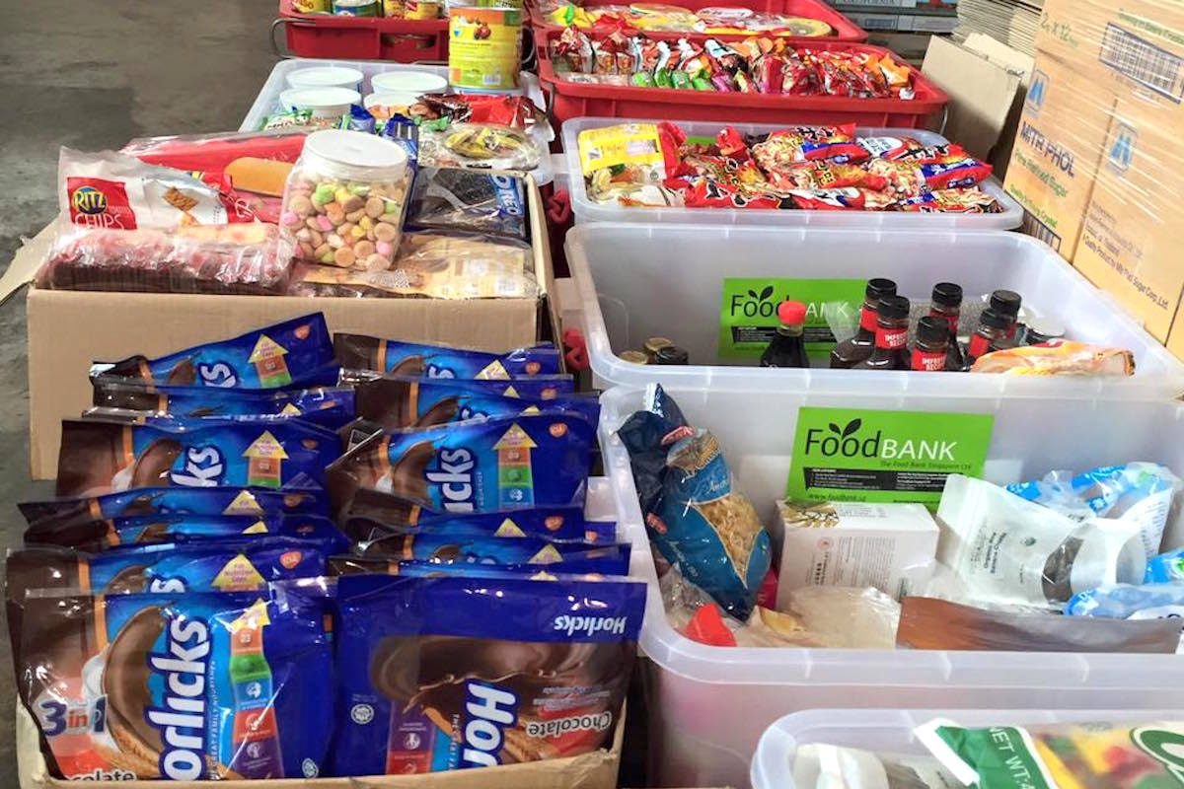

Slide 45
Some considerations
No regulations in place to achieve food waste management strategy
Strong food safety regulations, unclear liabilities
Culturally and socially accessible and acceptable food?

Slide 46
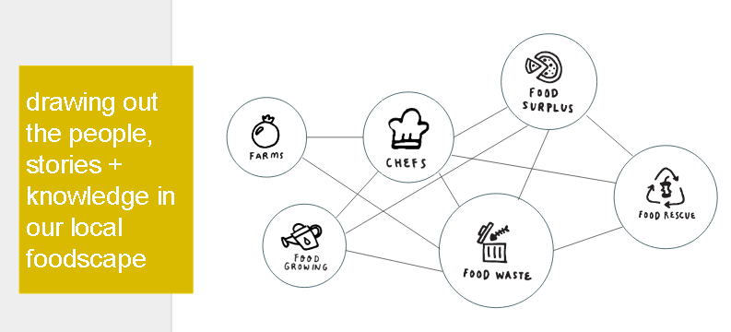
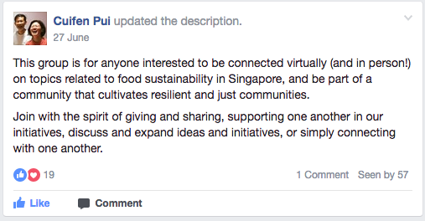

Slide 47
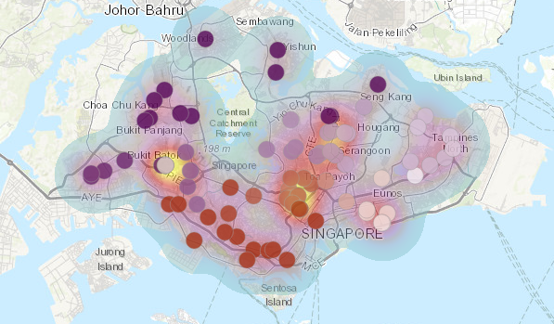
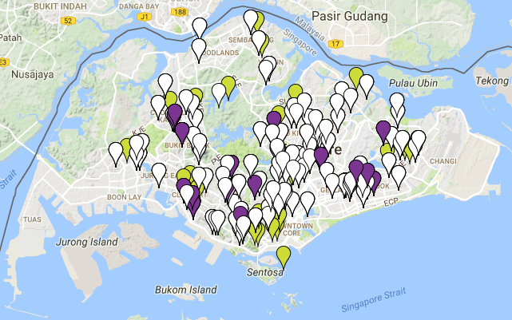
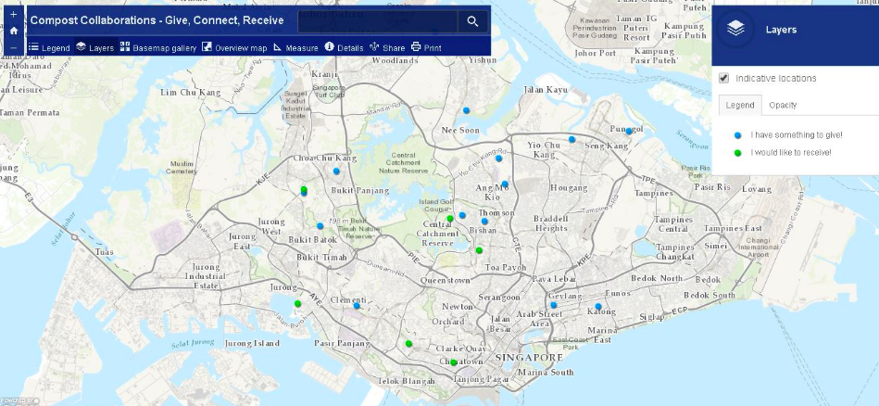

Slide 48
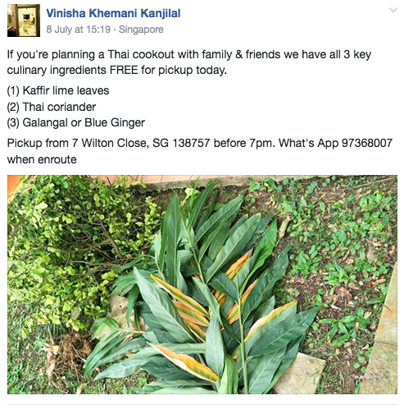
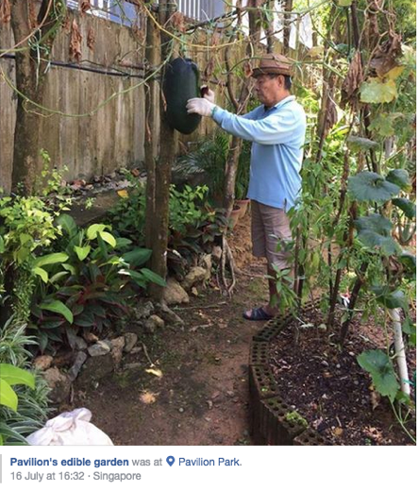
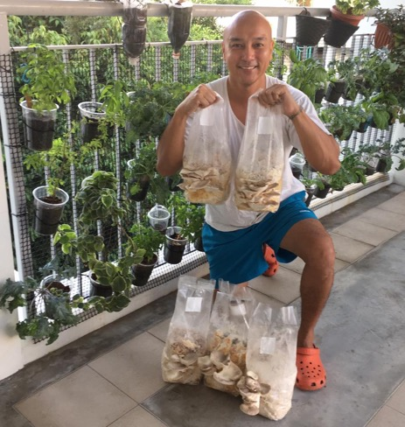




Slide 49





Slide 50
Some considerations
Spaces – in between, intermediary actors, soft interventions
Cooperative endeavors and everyday practices of sustainability
“Mediators” between civil society and the government?

Slide 51


Conclusions

Slide 52
Thank you!
Presentation by Monika Rut – rutm@tcd.ie
Trinity College Dublin, Ireland
www.sharecity.ie
@sharecityire

