Slide 1


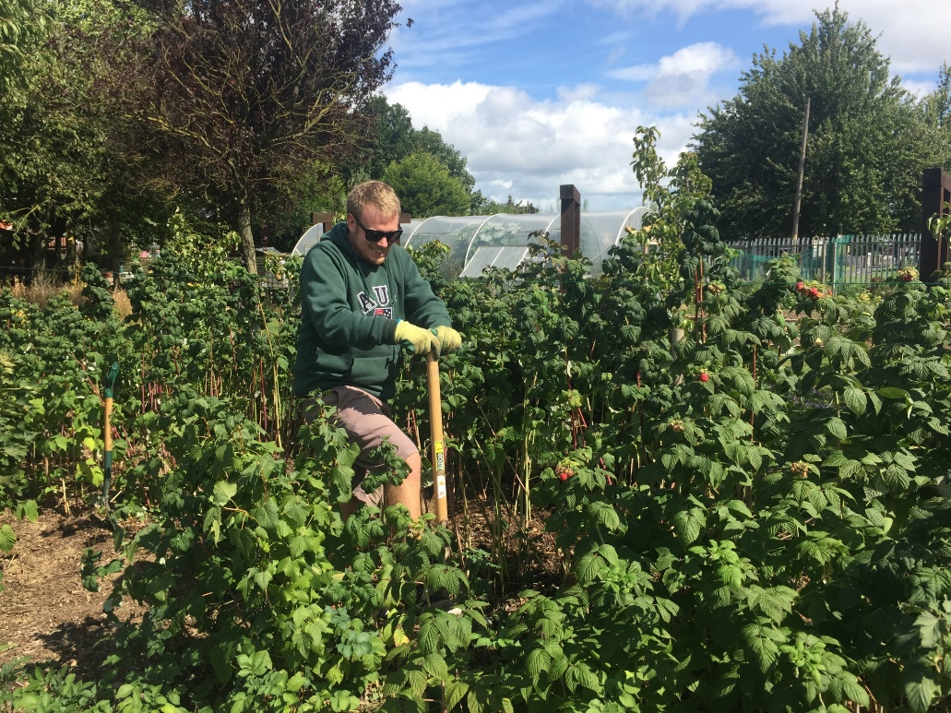
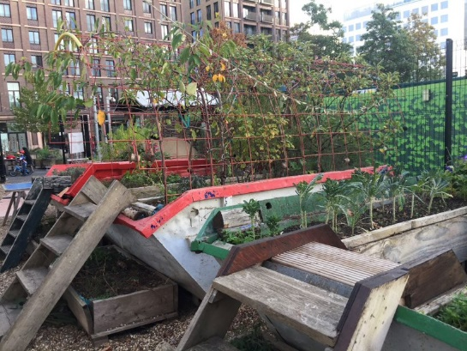
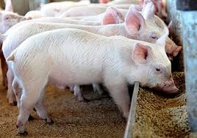
Falling between stools?
Straddling disciplines within academia and discovering the limits of quantitative approaches in transdisciplinary research
Dr Stephen Mackenzie
Trinity College Dublin and Newcastle University

Slide 2


Academic background – pre postdoc
BSc – Chemistry
MSc – Clean Technology (Engineering)
PhD – Animal Science: Modelling the environmental impacts of pig farming systems and the potential of nutritional solutions to mitigate them

Slide 3


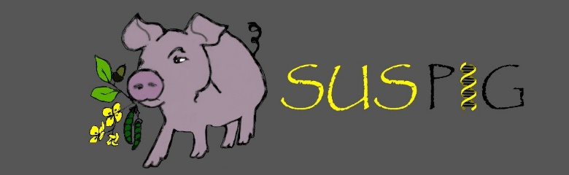
Modelling environmental impacts of animal production systems
Recent work in this area:
The potential of genetic change and breeding to reduce the environmental impact of pig production
The potential of smart management technologies to mitigate the environmental impacts of livestock systems
The implications of Animal health issues for the environmental impacts of livestock production

Slide 4
Modelling Techniques
Life Cycle Assessment
Marginal Abatement cost curves (Bio-economic modelling)
Genetic selection indices
Linear programming for system optimisation – e.g. feed formulation for livestock
Novel applications of uncertainty and sensitivity analysis techniques

Slide 5





Some of the industry partners from projects on livestock systems

Slide 6



SHARECITY
SHARECITY is a 5-year research project funded by the European Research Council which is exploring the practice and sustainability potential of city-based food sharing economies.
Aims & Objectives
To establish the significance and potential of food sharing economies to transform cities onto more sustainable pathways
Develop deeper theoretical understanding of contemporary food sharing
Generate comparative international empirical data about food sharing activities within cities
Assess the impact of food sharing activities on urban food sustainability
Explore how food sharing in cities might evolve in the future
Food sharing definition used - having a portion [of food] with another or others; giving a portion [of food] to others; using, occupying or enjoying [food and food related spaces to include the growing, cooking and/or eating of food] jointly; possessing an interest [in food] in common; or telling someone about [food]” (Davies and Legg, 2018: 237)

Slide 7
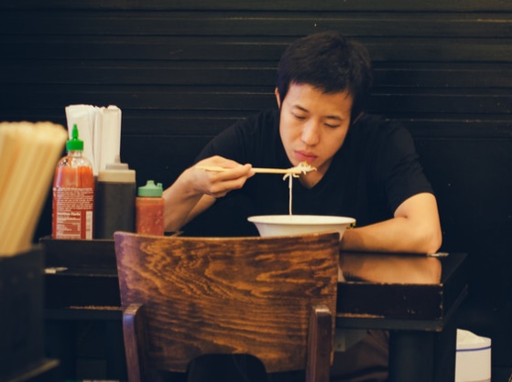
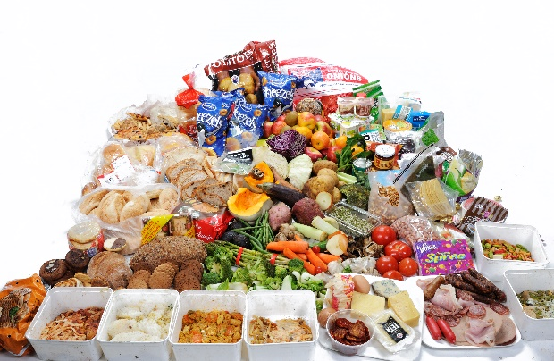
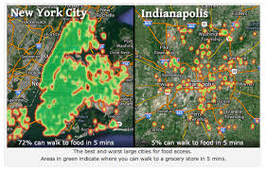
Why focus on urban food sustainability?
~ 70% of global population living in cities by 2050
Issues for Urban Food Systems
  Social
  Increased Isolation (dining alone), Food Poverty, Detachment from Food and Nature
  Environmental
  Land Use Change, Food Waste, Increased Meat Consumption
  Economic
  Fair Returns to Farmers, Affordability and Accessibility, New & Diverse Food Economies
SOCIETAL META-CHALLENGE
To transform urban food systems in a just and sustainable manner
SHARECITY INNOVATION
Reframing debates to include city-based food sharing
economies

Slide 8
Food sharing - very diverse
70 % of initiatives share multiple food related stuff, spaces or skills
53 % of initiatives share via multiple methods
21 % of initiatives use multiple organisational structures

Slide 9
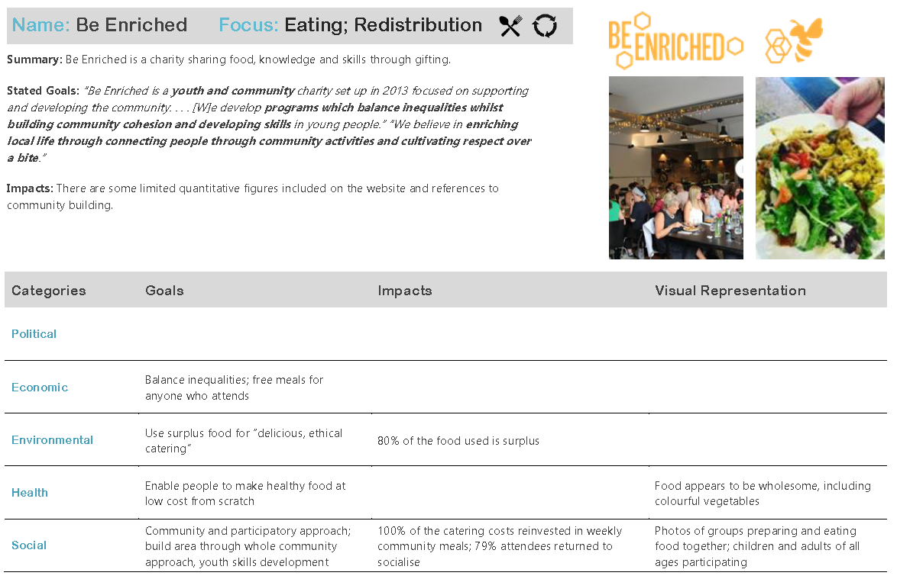
Case study example: Be Enriched
Summary of Be- Enriched activities:
• Provide important shared eating experiences to those who may otherwise not have them
• Provide weekly access to balanced cooked meals using fresh ingredients for those who otherwise may not get them
• Provide education on food safety, nutrition, cooking skills and food budgeting for youth groups and broader audiences in the form of cooking classes and take home educational materials
• Use platform (particularly online) to engage in activism to promote changes in food policy and increase access to healthy, affordable food for everyone through grassroots campaigns

Slide 10
The tricky bits: the value of shared eating experiences
  Be-Enriched quite specific that participants in their canteens say they come for the company not the food!
  Shared eating is known to alleviate loneliness and increase levels of life satisfaction, happiness and trust in local community (Dunbar, 2017)
  Dining habits themselves, and more specifically the number of meals consumed by an individual that are shared and with whom, are a modern indicator of social capital (Julier, 2013)
  In fact the frequency of social dinners has been shown to be correlated with the size of an individuals close support network (Dunbar, 2017)
  But can delivering shared eating experiences be reported as an impact in its own right? What value frequency, regularity etc.?

Slide 11
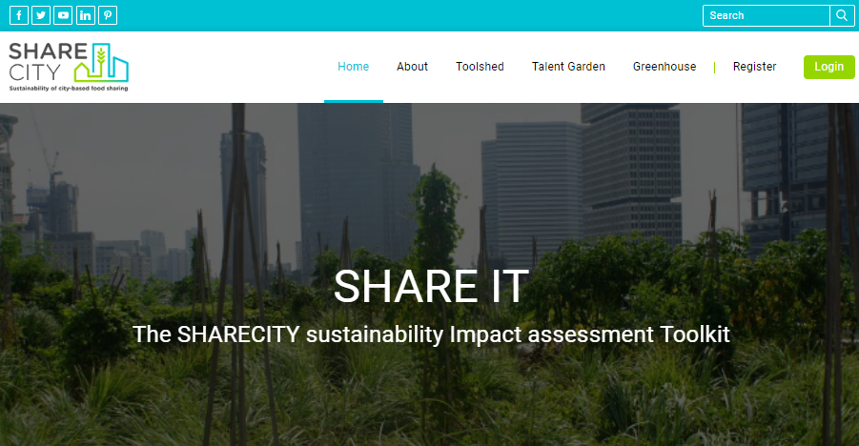
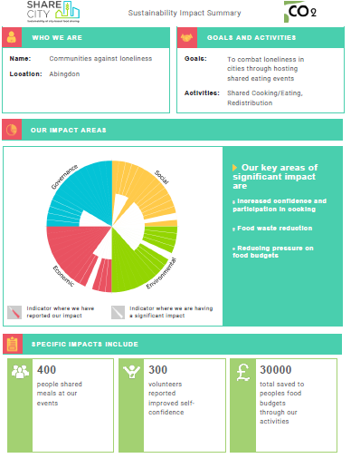
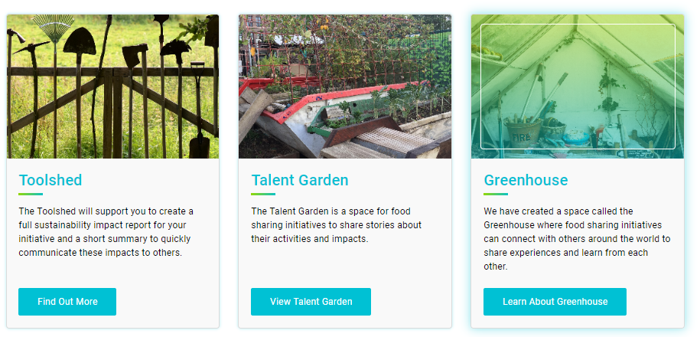
The SHARE IT toolkit

Slide 12
The Co-design process
Direct co-design with initiatives
Desk based research
Review
Workshop 1
Review of Sustainability Impact Assessment (SIA) methodologies for urban food systems
Match relevant indicators to stated goals of initiatives
Establish the initiatives:
Current impact reporting practices
Reporting goals and needs for the future
Realistic reporting capabilities
Respond
Workshop 2
Analysis of needs and capabilities
Review of relevant literature beyond existing SIA methodologies for urban food systems
Development of preliminary indicator suite
Consideration of indicator suite
Challenges of data collection
Gap analysis
Refine
Workshop 3
Refinement of indicator suite
Identification of additional indicators
Development of SHARE IT process & concepts
Reflection on indicator suite
Consideration of SIA indicator framework (Toolshed)
Additional concepts added to SHARE IT
(Talent Garden + Greenhouse)
SHARE IT Toolkit
Talent Garden
Toolshed
Greenhouse

Slide 13
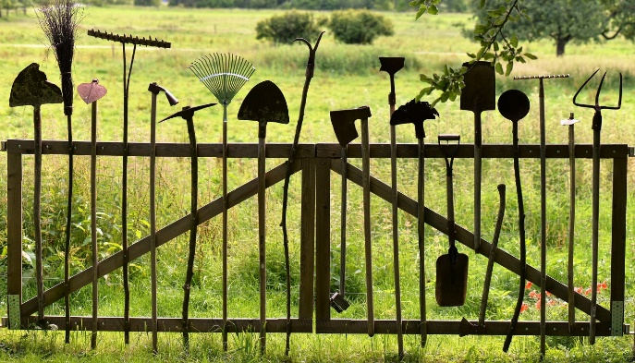

SHARE IT – FUNCTIONS shareit.sharecity.ie
The Toolshed
The Talent Garden
The Greenhouse
A resource where initiatives can create a full Sustainability Impact Assessment report of their activities.
Also produces a 3 page summary report of impacts as a communication tool for potential funders etc.
The Talent Garden is a space for food sharing initiatives around the world to share stories about their activities and impacts.
These can be written stories, images, videos or even reports that are generated in the Toolshed.
A space where food sharing initiatives can connect with others around the world to share experiences and learn from each other

Slide 14
The Toolshed
Driving the Toolshed is a sustainability impact assessment (SIA) framework developed specifically for food sharing initiatives
The framework contains 34 indicators across 4 pillars of sustainability: Economic, Environmental, Governance and Social
Framework based on existing SIA frameworks + novel indicators specific to the activities of food sharing initiatives
The tool links reported impact areas directly to the relevant UN sustainable development goals
The framework is designed to consider impact at the organisational level

Slide 15
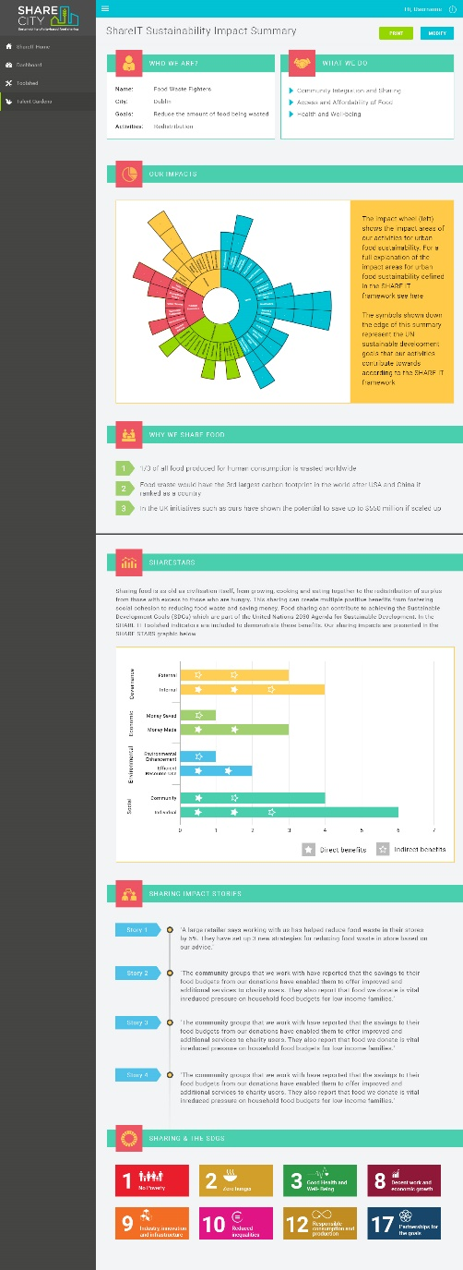
Impact areas not traditionally considered
The Toolshed integrated a number of impact areas beyond those traditionally considered in SIA of food systems:
Increasing levels of meal sharing
Increasing the friendship/support network of participants
Increasing levels of self-efficacy amongst participants
The potential of food sharing initiatives to influence the choices and values of participants with respect to food

Slide 16
Research challenges
Ensuring the Sustainability Impact Assessment is both accessible and informative for initiatives who may have little time and resources to dedicate to impact reporting
But any assessment also needs to be considered rigorous enough for its outputs to be valued by funders and policy makers
Understanding the temporal considerations around the impact of sharing is a wicked problem!
Ethical considerations around the application of quantitative sustainability assessment to food sharing initiatives

Slide 17
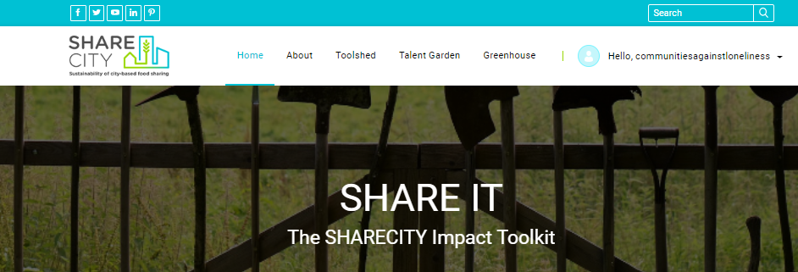
The SHARE IT toolkit
Launched in last week check it out - shareit.sharecity.ie
Already 14 food sharing initiatives registered
National initiatives including FoodCloud in Ireland and Ackerdemia in Germany have already made their reports

Slide 18
Some reflections from experience
Natural Science
Applied Science
Social Science
Straddling the boundary between natural and social sciences is challenging but can be a rewarding space to operate in

Slide 19
Some reflections from experience
Non-academic partners come in many different forms and need different approaches
Know exactly why you are taking a particular postdoctoral role
Don’t be surprised to experience imposter syndrome if changing research focus

Slide 20
Thank you for your attention
Stephen Mackenzie – mackenst@tcd.ie
Recent papers
Mackenzie, S.G. and Davies, A. (2019) SHARE IT: Challenges and opportunities in co-designing a sustainability assessment framework for urban food sharing initiatives. Environmental Impact Assessment Review. 79. Available online
Ottosen, M., Mackenzie, S.G., Wallace, M. and Kyriazakis, I. (2019) A method to account for the effect of genetic traits of pigs on the environmental impacts from their production system. International Journal of Life Cycle Assessment. Available online
Tallentire, C.W., Mackenzie, S.G. and Kyriazakis, I. (2018) Can novel ingredients replace soybeans and reduce the environmental burdens of European livestock systems in the future? Journal of Cleaner Production 187: 338-347.
Mackenzie, S.G., Wallace, M. and Kyriazakis, I. (2017) How effective can environmental taxes be in reducing the environmental impact of pig farming systems. Agricultural Systems. 152: 131-144

