Slide 1
SHARE-IT: Barriers and opportunities for reporting on the sustainability impacts of food sharing initiatives
Alwynne McGeever & Anna Davies
Trinity College Dublin, Ireland
The Future of Food Symposium 2021:
Track C
www.sharecity.ie
ERC Grant Agreement No: 646883

Slide 2
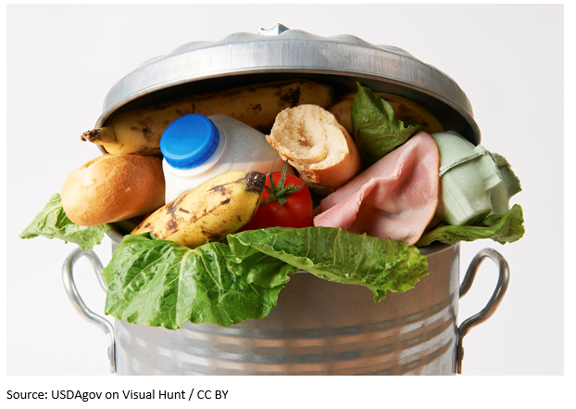
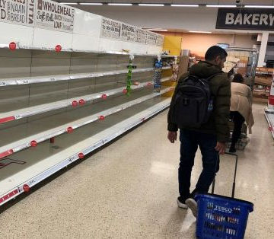
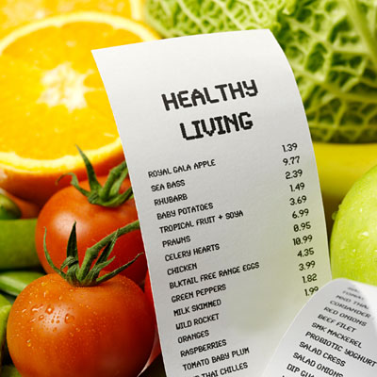
The Challenge: the food system is unsustainable
High Waste & Emissions
Vulnerable Supply Chain
Unjust
Notes:
Dublin’s food system is unsustainable. Some of the ways we can see this are in the high waste and emissions produced throughout the supply chain, the empty shelves indicating the supply disruption of the recent Covid pandemic, and the inherent unjust nature of an urban food system where healthy, organic, low waste food is economically and geographically inaccessible to large sectors of the population

Slide 3
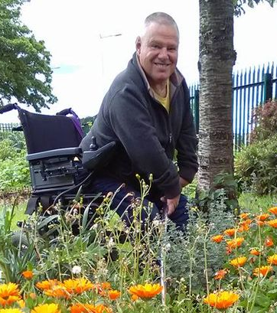
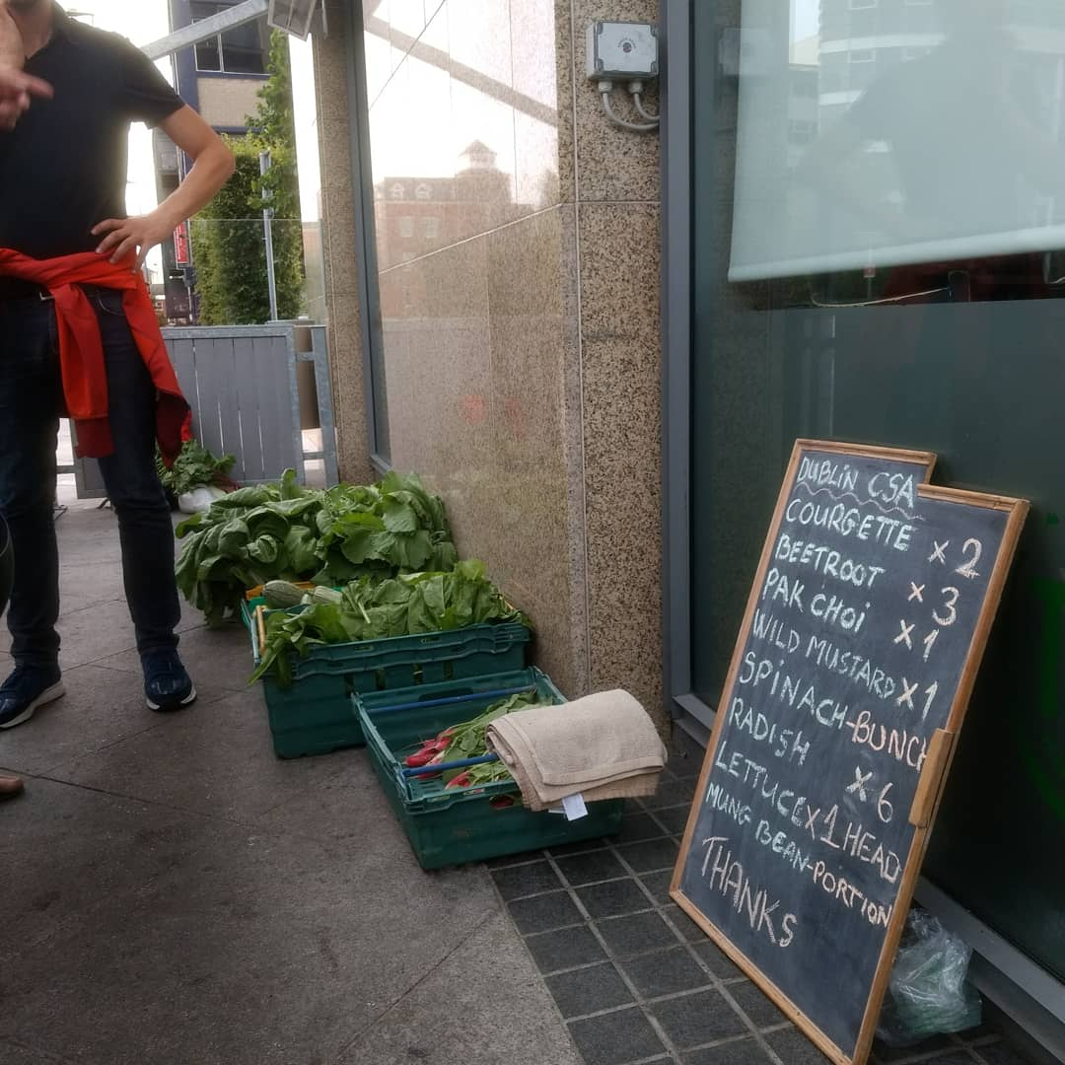
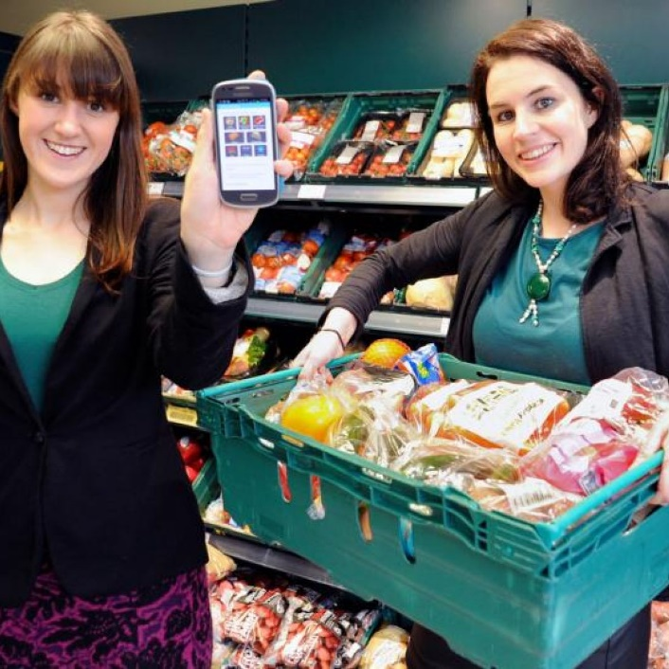
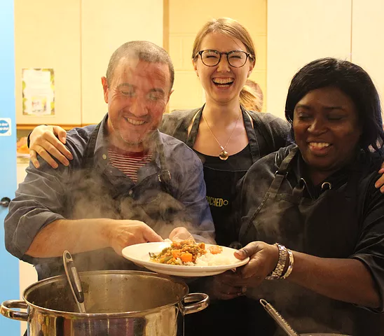
Food sharing initiatives are trying to change this
Community
Gardens
Community Supported Agriculture
Surplus
food
redistribution
Community
Kitchens
Notes:
Food sharers are trying to change this! By food sharers we mean any groups that grows food together, like the Muck and Magic community garden, groups that redistributed surplus and waste food, like food banks supplied by redistributors like FoodCloud, and groups that eat food together like community kitchens and social dining clubs. In Dublin we estimate that there are currently over 100 (??? AMG to fact check this in January) food sharing groups at work

Slide 4
What do we mean by food sharing?

Slide 5
What do we mean by food sharing?

Slide 6
What do we mean by food sharing?

Slide 7
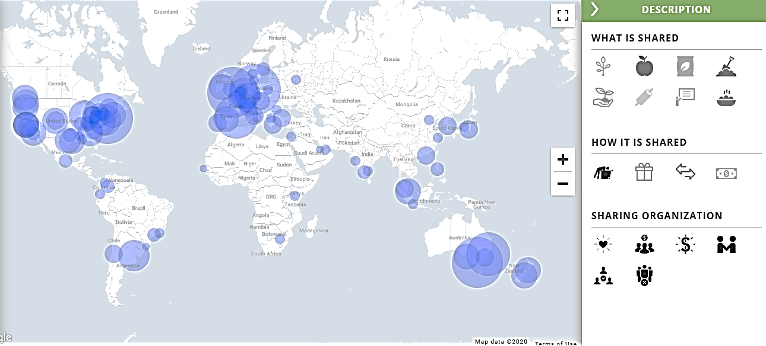
SHARECITY100 DATABASE

Slide 8
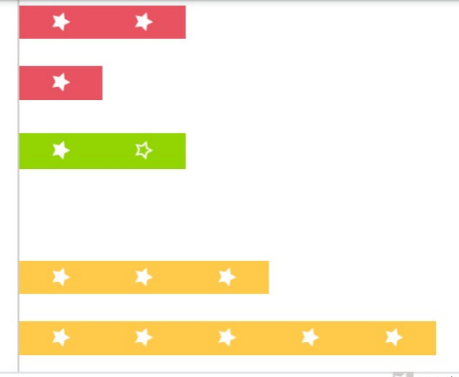
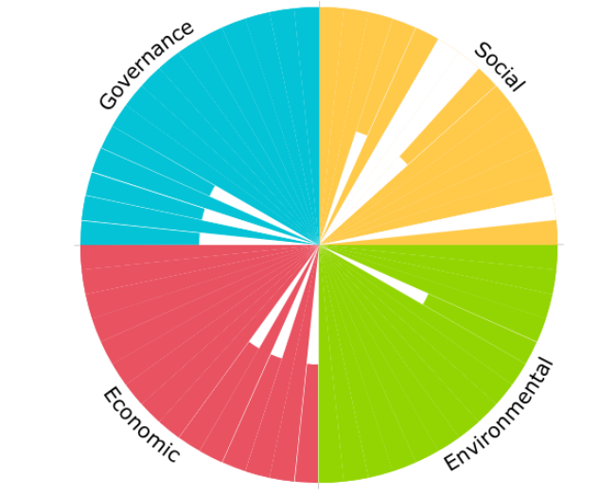
IT
SUSTAINABILITY IMPACT ASSESMENT TOOLKIT

Slide 9
SHARE IT
Measuring impact -
34 indicators
Impact visualisation & communication
Building a community of practice
Notes:
SHARE IT offers sustainability impact assessments to any group or enterprise that is focused on growing, eating or redistributing food. SHARE IT was co-designed with input, testing and feedback from food sharers. It has three key features. In the Toolshed there are 34 indicator questions that captures and analyses environmental, economic and social impacts. In the Talent Garden there is a virtual space to share learning and stories of impacts, raising visibility of these activities. And the Greenhouse provides a networking hub for food sharers to share learning with one another. Along with these online features online, the SHARE-IT team offers a consultancy service to assist food enterprises in completing their sustainability impact assessment.

Slide 10
Impact Areas
Environment | Social | Economic | Governance
Practices | Accessibility | Jobs | Risk Control
Emissions | Health & Wellbeing | Affordability | Strategic Planning
Waste | Community | Production | Civic Responsibility
34 questions with quantitative and/or qualitative answers

Slide 11
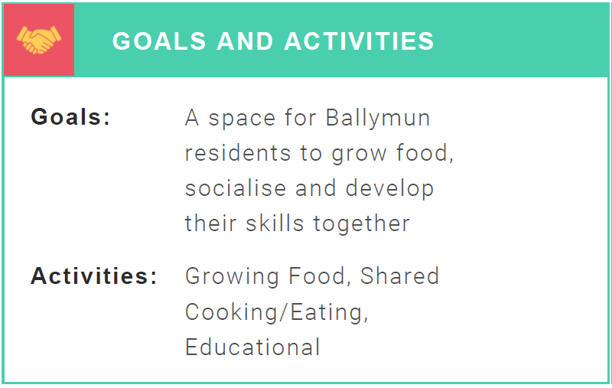
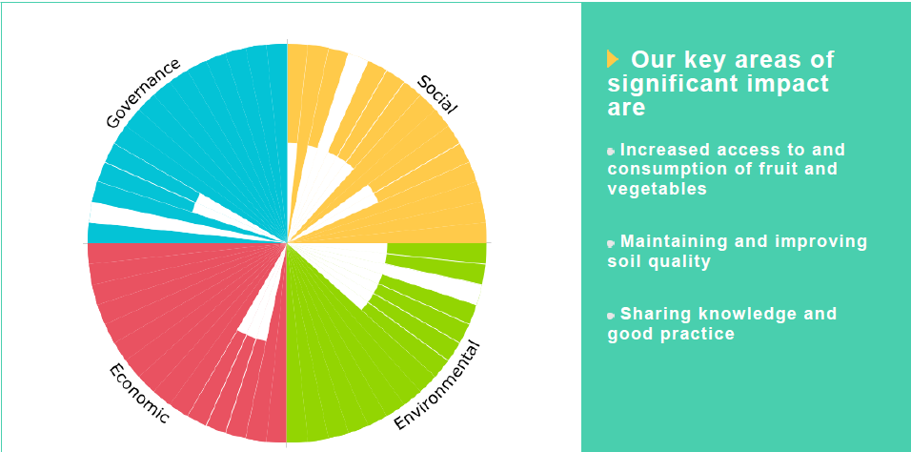
Output report

Slide 12
Does SHARE IT have a market case?

Slide 13
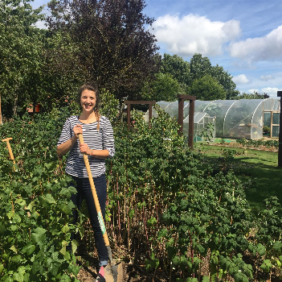
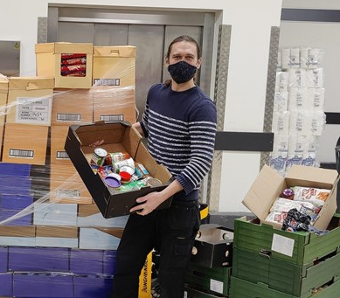
Does SHARE IT have a market case?
We identified three customer segments:
© the Gaurdian
© Neighbourly
Food sharing initiatives
Public Authorities
Food Retailers

Slide 14
Does SHARE IT have a market case?
We identified three customer segments:
© the Gaurdian
© Neighbourly
Food sharing initiatives
Public Authorities
Food Retailers
We had three questions:
Do you have a need for sustainability reporting from FSIs?
Does SHARE IT meet that need?
Are you willing to pay for SHARE IT to meet that need?
Method:
Interviews

Slide 15
What value does SHARE IT offer to FSIs

Slide 16
What value does SHARE IT offer to public authorities?
National & Local Authorities
Supporting food sharing
Land Policies Funding
Food
Sharing Initiatives

Slide 17
What value does SHARE IT offer to public authorities?
National & Local Authorities
Supporting food sharing
Land Policies Funding
Food
Sharing Initiatives
Strategically plan to maximise impacts
Communicate impacts internally and to public
Understand impacts
of their work
Identify progress towards SDGS

Slide 18
What value does SHARE IT offer to food retailers?
Food
Retailer
Charity
partners
Surplus food
Notes:
So how is food sharing made possible? Well in part thanks to the policies and funding available from Dublin City council, along with funding and food donations from super markets, as part of their CSR, and funding and human resources from volunteers. Food sharing practices are spread across diverse organisation types like charities, social enterprises and informal community groups

Slide 19
What value does SHARE IT offer to food retailers?
Food
Retailer
Charity
partners
Surplus food
Understand impacts of donations
Understand impacts
of their work
Communicate impacts
to customers
Inform future
CSR strategies
Notes:
So how is food sharing made possible? Well in part thanks to the policies and funding available from Dublin City council, along with funding and food donations from super markets, as part of their CSR, and funding and human resources from volunteers. Food sharing practices are spread across diverse organisation types like charities, social enterprises and informal community groups

Slide 20
Data collected from 10 stakeholder interviews:
© the Gaurdian
© Neighbourly
Food sharing initiatives
Public Authorities
Food Retailers
1 urban farm
2 surplus food redistributors
3 national public authorities
1 international network of city authorities
2 supermarkets
1 food wholesaler
1 food consumer goods coalition
Additional pre-existing SHARECITY data:
Detailed feedback from 10 FSI pilot user testers
Detailed feedback from a workshop with policy makers

Slide 21
Findings from 10 stakeholder interviews:
There is a need for sustainability reporting from FSIs
Confirmed by all three stakeholders
SHARE IT’s design and approach effectively meets that need
Confirmed by all three stakeholders
There is not a willingness/ ability to pay for SHARE IT (yet!)
Confirmed by all three stakeholders

Slide 22
Need for FSI
sustainability reporting
Food Sharing Initiatives
Need: evidence to build a case for more funding, better policy supports and more value placed on societal and environmental impacts
Public Authorities
Need: to report on local progress towards global SDGs and national sustainability agenda
Food Retailers
Need: to reduce edible food waste and demonstrate impacts of corporate social responsibility to de risk possibility of green washing or social washing

Slide 23
Barriers for FSI
sustainability reporting
Need for FSI
sustainability reporting
Food Sharing Initiatives
Low reporting capacity
Need: evidence to build a case for more funding, better policy supports and more value placed on societal and environmental impacts
Cannot afford external support
Sustainability /SIA not a main goal
Public Authorities
Need: to report on local progress towards global SDGs and national sustainability agenda
Food Retailers
Need: to reduce edible food waste and demonstrate impacts of corporate social responsibility to de risk possibility of green washing or social washing

Slide 24
Barriers for FSI
sustainability reporting
Need for FSI
sustainability reporting
Food Sharing Initiatives
Low reporting capacity
Need: evidence to build a case for more funding, better policy supports and more value placed on societal and environmental impacts
Cannot afford external support
Sustainability /SIA not a main goal
Public Authorities
Siloed thinking and dispersed responsibility among social, environmental and economic governance departments
Need: to report on local progress towards global SDGs and national sustainability agenda
Lack of willingness to pay, and awareness and priority for FSIs from any one department
Food Retailers
Need: to reduce edible food waste and demonstrate impacts of corporate social responsibility to de risk possibility of green washing or social washing

Slide 25
Barriers for FSI
sustainability reporting
Need for FSI
sustainability reporting
Food Sharing Initiatives
Low reporting capacity
Need: evidence to build a case for more funding, better policy supports and more value placed on societal and environmental impacts
Cannot afford external support
Sustainability /SIA not a main goal
Public Authorities
Siloed thinking and dispersed responsibility among social, environmental and economic governance departments
Need: to report on local progress towards global SDGs and national sustainability agenda
Lack of willingness to pay, and awareness and priority for FSIs from any one department
Food Retailers
Need: to reduce edible food waste and demonstrate impacts of corporate social responsibility to de risk possibility of green washing or social washing
Lack of willingness to go beyond food donations and believe FSIs or public authorities should pay for sustainability report

Slide 26
Barriers for FSI
sustainability reporting
Supports needed to enable FSI sustainability reporting
Food Sharing Initiatives
Low reporting capacity
Cannot afford external support
Sustainability /SIA not a main goal
Public Authorities
Siloed thinking and dispersed responsibility among social, environmental and economic governance departments
Lack of willingness to pay, and awareness and priority for FSIs from any one department
Food Retailers
Lack of willingness to go beyond food donations and believe FSIs or public authorities should pay for sustainability report

Slide 27
Barriers for FSI
sustainability reporting
Supports needed to enable FSI sustainability reporting
Food Sharing Initiatives
Low reporting capacity
Provide: external free/affordable support to enable data collection and reporting
Cannot afford external support
Sustainability /SIA not a main goal
Public Authorities
Siloed thinking and dispersed responsibility among social, environmental and economic governance departments
Lack of willingness to pay, and awareness and priority for FSIs from any one department
Food Retailers
Lack of willingness to go beyond food donations and believe FSIs or public authorities should pay for sustainability report

Slide 28
Barriers for FSI
sustainability reporting
Supports needed to enable FSI sustainability reporting
Food Sharing Initiatives
Low reporting capacity
Provide: external free/affordable support to enable data collection and reporting
Cannot afford external support
Sustainability /SIA not a main goal
Public Authorities
Siloed thinking and dispersed responsibility among social, environmental and economic governance departments
Design: Governance mechanisms to enable holistic sustainability policy and funding decisions across social, environmental and economic sectors
Lack of willingness to pay, and awareness and priority for FSIs from any one department
Food Retailers
Lack of willingness to go beyond food donations and believe FSIs or public authorities should pay for sustainability report

Slide 29
Barriers for FSI
sustainability reporting
Supports needed to enable FSI sustainability reporting
Food Sharing Initiatives
Low reporting capacity
Provide: external free/affordable support to enable data collection and reporting
Cannot afford external support
Sustainability /SIA not a main goal
Public Authorities
Siloed thinking and dispersed responsibility among social, environmental and economic governance departments
Design: Governance mechanisms to enable holistic sustainability policy and funding decisions across social, environmental and economic sectors
Lack of willingness to pay, and awareness and priority for FSIs from any one department
Food Retailers
Incentivise reporting on end use of surplus food and fine edible food going to waste to make donating food (and associated reporting) financially competitive
Lack of willingness to go beyond food donations and believe FSIs or public authorities should pay for sustainability report

Slide 30
Next steps
Upgrades for SHARE IT prototype
Test different user support models to enable FSIs to report with free trials and further interviews
Test and validate the value propositions among other stakeholders with free trials and further interviews
Future food policy and governance workshops with policy makers

Slide 31
Website www.sharecity.ie www.shareit.sharecity.ie SHARECITY100 www.sharecity.ie/research/sharecity100-database/ Facebook https://www.facebook.com/sharecityresearch/ Twitter @ShareCityIre Email amcgeeve@tcd.ie
Thank you!
www.sharecity.ie
ERC Grant Agreement No: 646883

